Slide 1
Dive Into the World of Market Research
Office of Integrated Marketing
July 17, 2024
Notes:
Good afternoon everyone. I am excited to to be here today to talk about the the exciting world of market research.
My name is Amit Rajput and I am a market research analyst in GSA’s Office of Customer Care Market Research as a Service Division, most commonly known as the MRAS division.

Slide 2
Objectives
By the end of this training you will have a better understanding of:
Why market research is conducted
When to conduct market research
How to use MRAS service options to conduct market research
Notes:
The overall objective of todays session is to provide you a better understanding of the why, when, and how of market research.
Why market research is conducted in the first place and when you need to conduct research for your requirements.
And how you can utilize the services we offer under the MRAS to conduct fast, effective, and efficient market research so you are able to seek out solutions to meet your agency’s needs.

Slide 3
Agenda
Why Research?
Introduction to MRAS
Available Services
Value Added Benefits
How to Submit Market Research Request
Customer Success Story
Training and Resources
Q & A
Notes:
Today’s main focus is the MRAS. However, before I even begin talking about our amazing program I want to start off by covering why we conduct market research and go over some of the common techniques that are referenced in the regulations.
I will then introduce MRAS and show you ways we can help you conduct fast, effective, and efficient market research for your requirements.
I will then briefly go over the available market research service options we have to choose from and also highlight a few value added benefits of our program.
The next part of this training I will walk you through the steps of initiating a market research request. Additionally I show you examples of a market research report and what you can expect to see when you utilize our services.
I will wrap up this training with a customer success story and provide you with additional market research resources you can use.
I should have a good amount of time for questions at the end.
If you have questions at any point in the presentation, please type them in the chat and one of our MRAS SME’s will be able to answer them live.

Slide 4
Why Research?
To gain knowledge
To make informed decisions
To drive mission capabilities
To remain relevant, gain efficiency, and innovate
To understand market constraints and recognize opportunities
To start the conversation
To see the solutions
To listen to stakeholders
Notes:
So why conduct market research?
As you can see here, there are a lot of reasons why one requires research.
What’s most important is having a shared understanding of the questions you are trying to answer.
Sometimes the questions are about the requirements, sometimes they are about the vendors capabilities, and other times they are all about the contracts, or identifying small business.
When conducting market research it’s important to think about what it is you want for an outcome. Meaning, what questions need to be answered. Then it’s your job to design activities to answer those questions.
Ultimately the FAR says, Market research is conducted to determine if commercial items or nondevelopmental items are available to meet the Government’s needs or could be modified to meet the Government’s needs.
Of course the FAR says a lot more than this, so let’s briefly take a look at the regulations.

Slide 5
The Regulations - FAR Part 10
www.acquisition.gov/far/part-10
The Scope
The Policy
The Procedures
The Clauses
Notes:
The Federal Acquisition Regulations also known as the FAR has a section dedicated to market research under part 10.
FAR Part 10 Market Research is broken down into 4 sections, they are - scope, policy, procedures and clauses.
I am not going to go too much into the FAR, but I do want to touch upon the instances where the regulations state where market research is necessary.

Slide 6
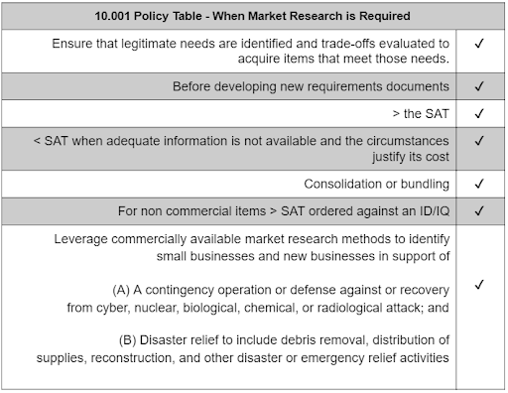
The Scope
www.acquisition.gov/far/part-10
By Regulation, there are 6 instances where market research is mandatory.
Best Practice Acquisition teams are always conducting market research, both formally and informally.
Notes:
Under this part, there are 6 instances listed where market research is mandatory. These are
1. Before developing new requirements documents. This usually means that instances where the agency has never purchased the item or service before.
2. Before soliciting offers for acquisitions in excess of the simplified acquisition threshold also known as the SAT.
3. Before soliciting offers for acquisitions LESS THAN the SAT when enough information is not available and the circumstances justify its cost. This is to ensure the Government can purchase efficiently and cost effectively. This type of research will assist Contracting Officers in determining what is fair and reasonable.
4. Market research is necessary Before soliciting offers for acquisitions that could lead to consolidation or bundling
5. Before awarding a task or delivery order under an IDIQ contract for a noncommercial item that is in excess of the simplified acquisition threshold.
6. And finally market research is necessary to identify the capabilities of small businesses to meet the requirements of the agency in situations like contingency operations and Disaster relief.

Slide 7
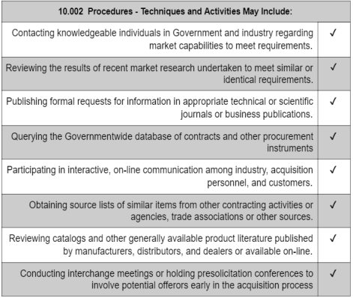
How to Research?
www.acquisition.gov/far/part-10
Notes:
FAR part 10 also outlines procedures and guidance on techniques you can use when conducting market research. You can use any or all of these methods shown here for market research.
Of course the extent of market research will vary depending on the urgency, estimated dollar value, and complexity of the requirement.
One thing to keep in mind is that Contracting Officers can use market research conducted within 18 months before contract award as long as the information is still current, accurate and relevant.

Slide 8
Poll Question 1:
What Type of Market Research Tools do you use most often?

Slide 9
Introduction to Market Research as a Service (MRAS)
MRAS uses the latest research techniques to help agencies visualize the competition and socioeconomic responses that they can expect if they use GSA’s acquisition vehicles.
Notes:
Now that we have briefly talked about the why market research is conducted and the common market research methods outlined in the regulations, Let me introduce you to a way you can conduct market research in an easy and effective way that also complies with some of the FAR techniques discussed and meets regulatory compliance.
GSA’s Market Research as a Service or MRAS for short is first and foremost a research tool that has been developed by GSA to help buyers with their market research.
It is a Free Service and the main purpose is so you can find GSA contract solutions that align with your specific needs.
You can use MRAS to research on products and services and find contractors under our various purchasing programs that are interested and potentially capable of performing your intended requirement.
With MRAS we do the research for you, engage our industry partners on your behalf, and provide you with results in an easy to read market research report.
These market research reports help you visualize the competition and socio-economic responses that you can expect if you use one of GSA’s acquisition vehicles.
Later on in this presentation I will dive into what a typical market research report looks like but first lets talk about some of the available market research options you can choose from.

Slide 10
Poll Question 2:
Have you ever used GSA's MRAS tools before?

Slide 11
Available Service Options
GSA Advantage Product Research | Rapid Review | Request for Information/Market Research Report | Industry Engagement
Search up to 20,000 items on GSA Advantage at once | Identifies if your requirement fits under an existing GSA acquisition solution. Results are provided within 24-48 hours. | Streamlines the RFI process and consolidates the results into one report with visuals. | Targeted industry engagement regarding Agency specific requirements during MRAS Industry sessions.
Notes:
Here is a summary of the types of services under MRAS.
1. The first service offering is the GSA Advantage Product Market Research. This research, as you can tell from the name, is specifically for products. We can research up to 20,000 items on GSA Advantage at once.
2. The second is Rapid Review. You can request a market report that provides a list of approved vendors on GSA’s Multiple Award Schedule and its subcategories, to help you identify approved sources within 24 to 48 hours. We provide you with NAICS results based on the description of the requirement and we give you up to 5 applicable GSA contracts ranked by compatibility, including Best In Class GSA contracts.
3. And the third, is the MRAS RFI/Market Research Report. This is our most popular service offering. Through this option, we work with you to understand your requirement and develop a customized RFI for you where we post on GSAeBuy on your behalf. We also provide you with a market research report consolidating all responses received including socio-economic information, contractor capabilities, industry feedback, and all responses to any technical questions asked in the RFI. You are able to use the information from this market research report to establish your acquisition strategy.
4. And finally we have our Industry Outreach. We invite our customers to attend our monthly MRAS industry training sessions so that you can connect with our industry partners to discuss your current MRAS RFI. This is a great way to generate more interest in your RFI and to get valuable feedback from industry. We usually have anywhere from 150-300 attendees and they are very engaged.

Slide 12
GSA Advantage! Multiple Part Number Search & Market Research
Search up to 20,000 parts at once
Receive all the GSA Advantage! data
Enhanced commodity market report on demand
Builds part number based market reports quickly
Includes One-on-One CSD Review of Report
****A list of part numbers/descriptions will need to be uploaded with your request
Notes:
So let dive a little deeper into each of these service offering so you can better understand how each one can help you conduct the appropriate market research based on your specific reqeuirement.
If you require research on specific products and want to identify approved sources that are on GSA Advantage, you can choose this from this option. We can search up to 20,000 items on GSA Advantage at once searching by part numbers and descriptions you provide. When you submit this request we have a template you can use to fill out part numbers and descriptions and is available on our MRAS request form.
When you use the product market research, we provide you with a commodity market resport within 1-2 days. These reports include price information, contract number, and socio-econmic status of available sources.

Slide 13
MRAS Rapid Review
Determine if your requirement fits under a GSA solution
List of approved vendors on GSA contract solutions
Results delivered within 24-48 hours
Notes:
The next service offering I want to talk about is the rapid review.
The way a rapid review works is that you provide as much detail as possible regarding an upcoming requirement and a GSA Customer Service Director (CSD) will work with you to identify potential GSA solutions that are compatible to meet your needs.
Based on the information provided and a review of the technical summary or Statement of Work, we will work with you directly to determine the most relevant GSA contracts/solutions and contractors available under those contracts.
When you opt for this research you will receive a market report that provides a list of GSA contract solutions and current contractor information under those solutions which align to your requirement. These results are shared with you within 24-48 hours.
vendors on GSA’s contract solutions that align with your requirement.Multiple Award Schedule and its subcategories, to help you identify approved sources within 24 to 48 hours. We provide you with NAICS results based on the description of the requirement and we give you up to 5 applicable GSA contracts ranked by compatibility, including Best In Class GSA contract solutions.

Slide 14
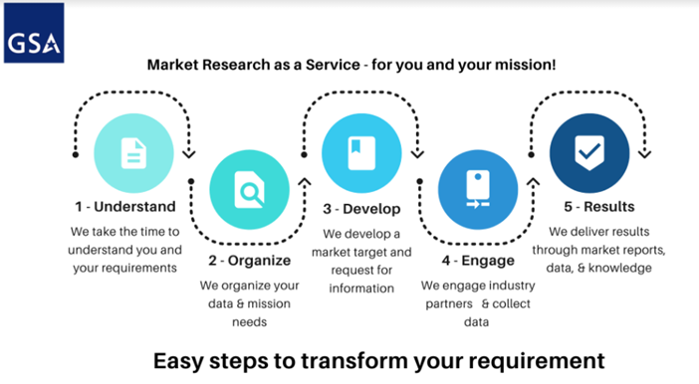
MRAS RFI Process
Notes:
And finally, there is the MRAS Request for Information or RFI.
As mentioned before, this is our most popular service option.
If you choose this option, you will be assigned a GSA Customer Service Director who will work with you to better understand your requirement and the needs of your agency. The MRAS team will work directly with your Customer Service Director to develop a customized RFI based on the specifics of your requirement.
Your customized RFI can include setting aside the requirement for small business, adding specific technical questions you want our industry partners to respond to, and including your Statement of Work or Performance Work Statement or any other attachments you want our industry partners to view and provide feedback. We also ask for contractor capabilities so you will have access to that as well.
The MRAS team will post the RFI on your behalf, engage our industry partners, and collect all data and responses received.
When the RFI closes and all data is collected, we will provide you with a Market Research Report summarizing all interested sources under each GSA contract solution.
The report will contain information, breakdown of socio-economic responses, answers to all technical questions, access to contractor capabilities and feedback, and a recommendation to an acquisition solution based on our findings.

Slide 15
How We Research
Use commercially available software to streamline the process
Ask yes or no questions, ranges, pre-set percentages, and more
Customize questions with visualizations and creating data sets in mind
We can ask industry for videos, websites, demos, manuals, and more
Notes:
With our RFIs we follow a standard, so that industry knows what to expect.
For commodities we might ask for things like demo videos and for services we may ask questions around common standards.
Our questions are built around how we want to visualize the data for our customers.
So wherever possible we ask yes/no questions and/or multiple choice questions.
We also ask industry to expand their answer in a streamlined capability statement which is typically 3 pages or less, and is usually optional.

Slide 16
MRAS Value Added Benefits
Free Service
Customized Research with Market Research Report
Reduced Acquisition Lead Time
Regulatory Compliance
Promotes category management
100% Direct Support from your Customer Service Director (CSD)
Notes:
Now that you know what type of market research services we offer, lets talk about some of the value added benefits our MRAS program can offer you.
1.Free: There is absolutely no cost when you use our service. You also do not have to be a Contracting Officer or specialist to conduct research. MRAS can be used by anybody that is involved in the acquisition support of the requirement.
2. Customized Research: With MRAS you are able to customize your market research. We work with you to better understand your requirement so we can conduct the appropriate market research. You have the ability to choose which type of research you want and you can also pick which specific contracts you want researched. If you desire to just research small businesses, we can do that as well!
I just discussed market research reports you will receive for each market research option you choose. All our reports show visualized results and data for easy readability and understanding
4. Reduces Acquisition Lead Time: Another value added benefit of using MRAS is that your procurement acquisition lead time is drastically reduced. We conduct all the market research, engage industry partners on your behalf, and deliver you the results in as little as 2 weeks.
5. FAR Part 10 Compliant: Earlier on we discussed a little bit about FAR part 10-market research. From a regulatory standpoint MRAS is compliant with FAR Part 10 market research practices and techniques.
6. Promotes Category Management: Using the services available under MRAS promotes category management as it delivers more savings, value, and efficiency. Our research reviews all GSA contracts that align with your requirement and identifies different Best in Class contracts that are out there that can potentially meet your needs. We can research our popular GWACS, Multi Agency Contracts, and our various GSA Schedule contract categories.
7. Customer Service Director: Last but not least is that you are 100% supported in this effort by your Customer Service Director. Your CSD will work with you on any market research you need and guide you through the MRAS process and available research options. Our MRAS team works directly with the CSD to better understand your requirement so we can conduct the most effective market research for you..

Slide 17
MRAS Service Request Form
Initiating Your Request
Notes:
Now you are probably asking yourself, all this sounds great….where do I start?
I’d like to show you how to initiate your request so that we can start your market research.

Slide 18
Buy.GSA.gov/MRAS
Select the Service you would like to utilize
Notes:
The first step is to go to Buy.GSA.gov/MRAS
By visiting this site you can access our service request form when you select the type of market research service you would like. As you can see here you have the option to chose RFI, product market research, or a rapid review.

Slide 19
Completing the Service Request Form
Notes:
Once you click on a search option, it will take you to the MRAS service request form shown here. Again, you will select which option you want to choose from.

Slide 20
Completing the Service Request Form
Notes:
In this example, I chose the RFI market research.
You will fill out the necessary information on your requirement including the project title, estimated solicitation and award date which are optional fields, the summary of requirement and estimated dollar value.

Slide 21
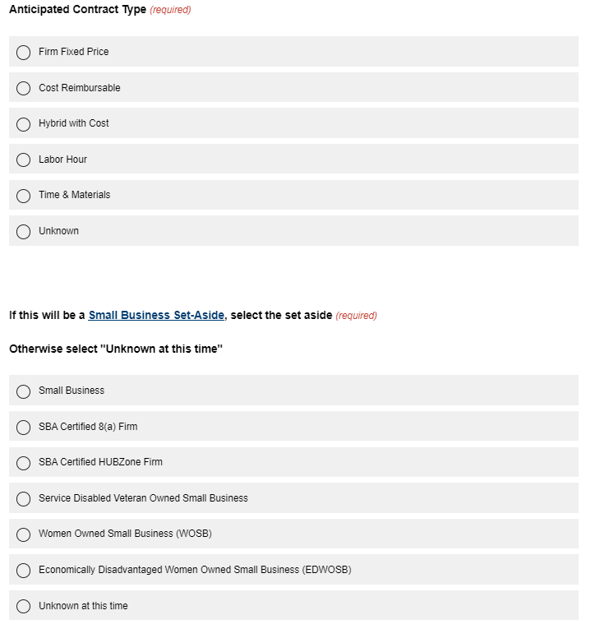
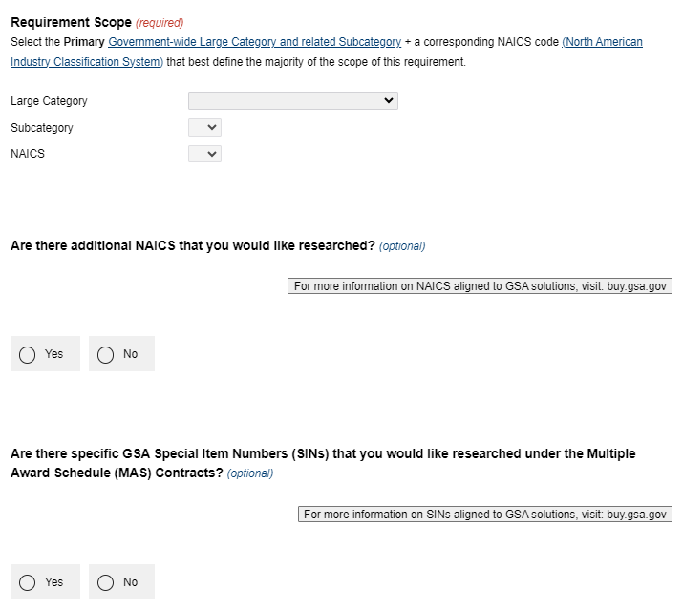
Completing Service Request Form
Notes:
The next screen will ask you for any additional information pertaining to your requirement.
Here you can choose the anticipated contract type, select any set-asides, and choose the category of your requirement.

Slide 22
Completing Service Request Form, Continued
Notes:
The next section will show you how you can upload any technical questions. We do have a template on sample market research questions which includes standard questions that are always going to be in all our RFIs. If you have other questions you want to include you can include that here as well.

Slide 23
Summary of Intake Requirements
Required:
Requirements document (SOW, PWS, SOO)
Category and primary NAICS code
RFI Close Date
Optional:
IGCE
Set-aside preference
Technical Questions
Notes:
The intake form will also ask you to upload your requirements document. This can be your draft Statement of Work or Performance Work Statement. You also have the option to include an IGCE (governrmnt cost estimate). Keep in mind that if this is included the information will not be shared with industry.
You also need to select the NAICS code and primary category of your requirement.
Once you click on RFI you will fill out all the necessary information pertaining to your requirement.
Some of these selections include agency/POC information, a brief summary, estimated value, anticipated contract type, and place of performance. Keep in mind that the estimated value is information that will not be shared with our industry partners.
Other information that is not shared with our industry partners is the estimated solicitation date and /or award date. These are option sections you can fill out.
Lastly, you can choose the option to set-aside this research or not. IF you pick a small business set aside, our RFI we develop will only go out to GSA contracts that have contractors that are 100% small businesses.

Slide 24
Sample MRAS Request for Information (RFI)
Notes:
Now I’d like to take you through what one of our customized MRAS RFI’s looks like.

Slide 25
Sample MRAS RFI
We gather small business and vendor socio-economic data in the survey.
We include a link to the requirements documents in the RFI
Notes:
This is a screenshot of one of our RFIs. In this RFI, as with all of our RFI’s we include a description of the Scope and a date for when responses are due as you can see on the left.
We include standard questions such as whether the firm would submit an offer, what GSA contracts they hold and any SINs (Special Item numbers) or NAICS (North American Industry Classification System Code) numbers that are applicable to the requirement. We also ask industry about their business size and socioeconomic designations (as you can see on the right) so that we can summarize in an easy-to-read report, all the available small businesses that can meet your requirement.

Slide 26
Sample MRAS RFI, Continued
Technical Questions can be added and customized based on the customer’s needs.
All vendor feedback provided will be summarized in a report, to ensure PWS/SOW requirements are clear
Vendors can expand on technical questions in their Capabilities Statement
Notes:
We then ask them to answer specific technical questions about the requirement, as you can see on the left hand side of the slide. In this section we can customize the way the questions are laid out, we can have sliding scales or multiple choice, it all depends on your needs. On the right hand side you’ll see that we also offer industry the opportunity to offer feedback on the requirement which we summarize in a report to you. They are also able to include an optional capabilities statement which we provide a link to in the final market research report to you.

Slide 27
Sample MRAS Market Research Report

Slide 28
Sample MRAS Report
The report provides a recommendation based on the number of respondents and the contracts researched.
Summarizes the socio-economic designations of interested parties.
Summarizes number of interested parties that are small or other than small businesses.
Summarizes number of interested parties by GSA contract vehicle.
Notes:
This is an example of what one of our Market Research Reports looks like. The report summarizes the requirement and provides our recommendation based on the number of responses. We put together visualizations based on the questions in the RFI. The report shows the number of interested parties as you can see on the top left. You can see that there are 5 interested sources and all of them are small businesses. The additional charts that show the GSA contracts these vendors hold, the recommended SINs or NAICs codes and a breakdown of the business size and socioeconomic status. We also break out if they provide the product/service commercially.

Slide 29
Sample MRAS Report, Continued
The report provides a directory of interested parties and their POC information.
We summarize feedback from Industry to ensure the requirement is clearly stated.
We provide a link to the vendors’ Capability Website and Capability Document.
Notes:
We also summarize industry feedback to you so that you can be sure the statement of work addresses any of their concerns and the requirement is clearly defined.
This page of the report is like a directory of sorts. It is a listing of all the interested sources, including their POC information, a link to their website and what SINs they hold. The report also includes links to the vendor’s capabilities statement that they have uploaded with their response to the RFI. This feature makes it easier to keep all pertinent documents in one place.

Slide 30
Sample MRAS Report, Cont.
Notes:
We summarize industry responses to any technical questions asked in the survey. It shows a summary of the number of vendors who responded and whether or not they can meet your requirement based on the specific technical questions asked in the survey.

Slide 31
Source Data and Raw Data Availability
We can also provide the source data collected with the RFI so that you can conduct further analysis if needed.
Notes:
In addition to the market research report we can also provide the Source Data or Raw data collected from the RFI. This would be useful for customers that would want to conduct further market research and breakdown the data in different ways.
I’d also like to point out that for customers who are working with shorter time frames, we do have a database of over a thousand MRAS reports that we can access to provide our customers with previous market research data to quickly help with all of your market research needs.

Slide 32
MRAS Success Story
Customer: Department of Homeland Security (DHS)
Requirement: HAZMAT Logistics Services to include daily inspections, waste consolidation, recycling center operations, overall warehouse management, and solid waste management tasks for the Coast Guard Base in Honolulu.
Results:
MRAS RFI process utilized to identify 4 interested small businesses under the Multiple Award Schedules.
Awarded Solution: GSA Multiple Award Schedule SIN 541620 Environmental Consulting Services to a small SDVOSB contractor.
Total Contract Award: $600k
Notes:
I wanted to share a recent story of how the MRAS has made a difference for GSA’s customers. Recently the Department of Homeland Security reached out to GSA regarding a requirement for hazmat logistics services assistance for the coast guard base in Honolulu.
Our GSA Customer Service Director worked with the DHS point of contact to understand the specifics of this requirement and helped our customer identify potential existing GSA acquisition solutions that fit the scope of work required.
Once these contract solutions were identified, the MRAS team created a customized RFI which targeted the contractors under these solutions.
Within 2 weeks, we delivered a consolidated market research report showing our customer exactly which contractors have the capability of performing the intended services and provided DHS a recommendation for their acquisition strategy.
This resulted in a $600,000 contract award to a service disabled veteran owned small business contractor under the GSA Multiple Award Schedule category for Environmental Consulting Services.

Slide 33
MRAS Success Story, Continued
Customer: US Army Milcon Design Review Support
Requirement: Engineering support for the National Guard Bureau (NGB) Army National
Guard (ARNG) headquarters office.
Results:
MRAS RFI process utilized to identify 6 interested small businesses under SIN 541330ENG and the OASIS Contract Vehicle.
Awarded Solution: GSA OASIS SB Pool 1
Total Contract Award: $5M
Notes:
I wanted to share a recent story of how the MRAS has made a difference for GSA’s customers. Recently the US ARMY reached out to GSA regarding a requirement for Milcon Design Review Support.
Our GSA Customer Service Director worked with the US Army point of contact to understand the specifics of this requirement and helped our customer identify potential existing GSA acquisition solutions that fit the scope of work required.
Once these contract solutions were identified, the MRAS team created a customized RFI which targeted the contractors under these solutions.
Within 2 weeks, We delivered a consolidated market research report showing our customer exactly which contractors have the capability of performing the intended services and provided the Army a recommendation for their acquisition strategy.
This resulted in a $5MM contract award to a small business contractor under the GSA OASIS SB Pool 1.

Slide 34
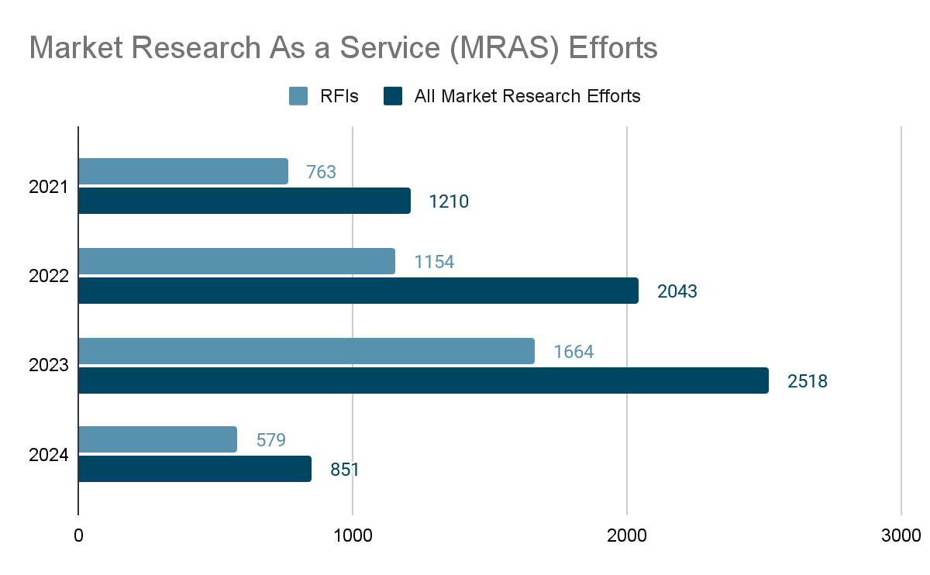
MRAS Program Successes
Awards
Over $54 Billion market research opportunities awarded to GSA Contract Holders.
Top Customers
Air Force
Army
Navy
Top Categories Researched
Professional Services
Information Technology
Facilities
Notes:
You just saw how MRAS can be used in the real world to seek out potential solutions to your requirements. Now I want to share some of the MRAS program successes we had in the past few years.
Since FY20, the MRAS program has awarded about $54 billion of all requirements researched to GSA contract holders. In FY 23 we researched over 1,500 RFI’s for customer agencies. Some of our top customers include the Air Force, Army, and Navy and the top categories researched range from professional services, IT, and facilities.

Slide 35
What Our Customers are Saying.....
"MRAS helped me avoid doing it the way it's always been done before."
"I am very satisfied with this process,...I am extremely happy with the results and plan to utilize the services again....I will share this positive experience with other supervisors in my organization and encourage them to utilize these services as well. Great Job!"
“...I used MRAS and in 10 days, had 40 people respond. GSA then went over the report and did a deep dive to identify specific socioeconomic factors. It was very helpful!"
"...the customer utilized the MRAS RFI process to determine their overall acquisition strategy. The MRAS program has proven to be a value added program!
Notes:
I’d like to share some of the positive feedback we are getting from our customers who really see the benefits we offer. We are constantly improving our process based on feedback from customers and industry to be able to give you the most accurate data in a short time frame and customers are really seeing the payoff of using our free market research services. I’ll just give you a minute to read them.

Slide 36
Resources
RFI@Research.GSA.gov
Buy.GSA.gov/MRAS
www.GSA.gov/CSD
Notes:
As I come to the end of my presentation, I’d like to share with you some resources that you can access to help you with your market research needs.
You can Email rfi@research.gsa.gov for more information regarding MRAS or if you have any questions about what I covered today.
To access the online form to submit your request after you reach out to your CSD you can Visit: buy.gsa.gov/mras. This webpage also gives you more information regarding MRAS.
And as I mentioned you can find your CSD at www.gsa.gov/CSD

Slide 37
ThankYou!
Office of Integrated Marketing

