Slide 1
Dive Into the World of Market Research
Office of Integrated Marketing
July 17, 2024

Slide 2
GSA Market Research eTools
presented by:
Michael Jordan
July 17, 2024

Slide 3
Agenda
eTools Overview
Advantage!
Global Supply
eLibrary
buy.gsa.gov
Live Demo

Slide 4
Advantage!
GSA Advantage is an online shopping and ordering system that provides access to thousands of contractors and millions of supplies (products) and services. Anyone may browse on GSA Advantage to view and compare the variety of products and services offered.
Federal government employees can make purchases on GSA Advantage using:
A governmentwide commercial purchase card (GSA SmartPay)
An Activity Address Code (AAC) or Department of Defense Activity Address Code (DoDAAC) (limited to purchases of GSA Global Supply items)
State and local government entities can now use GSA Advantage to purchase products and services under both the Cooperative Purchasing Program and the Disaster Purchasing Program. Payments for state and local government purchases on GSA Advantage are limited to credit card payments using a state or local government issued credit card.

Slide 5
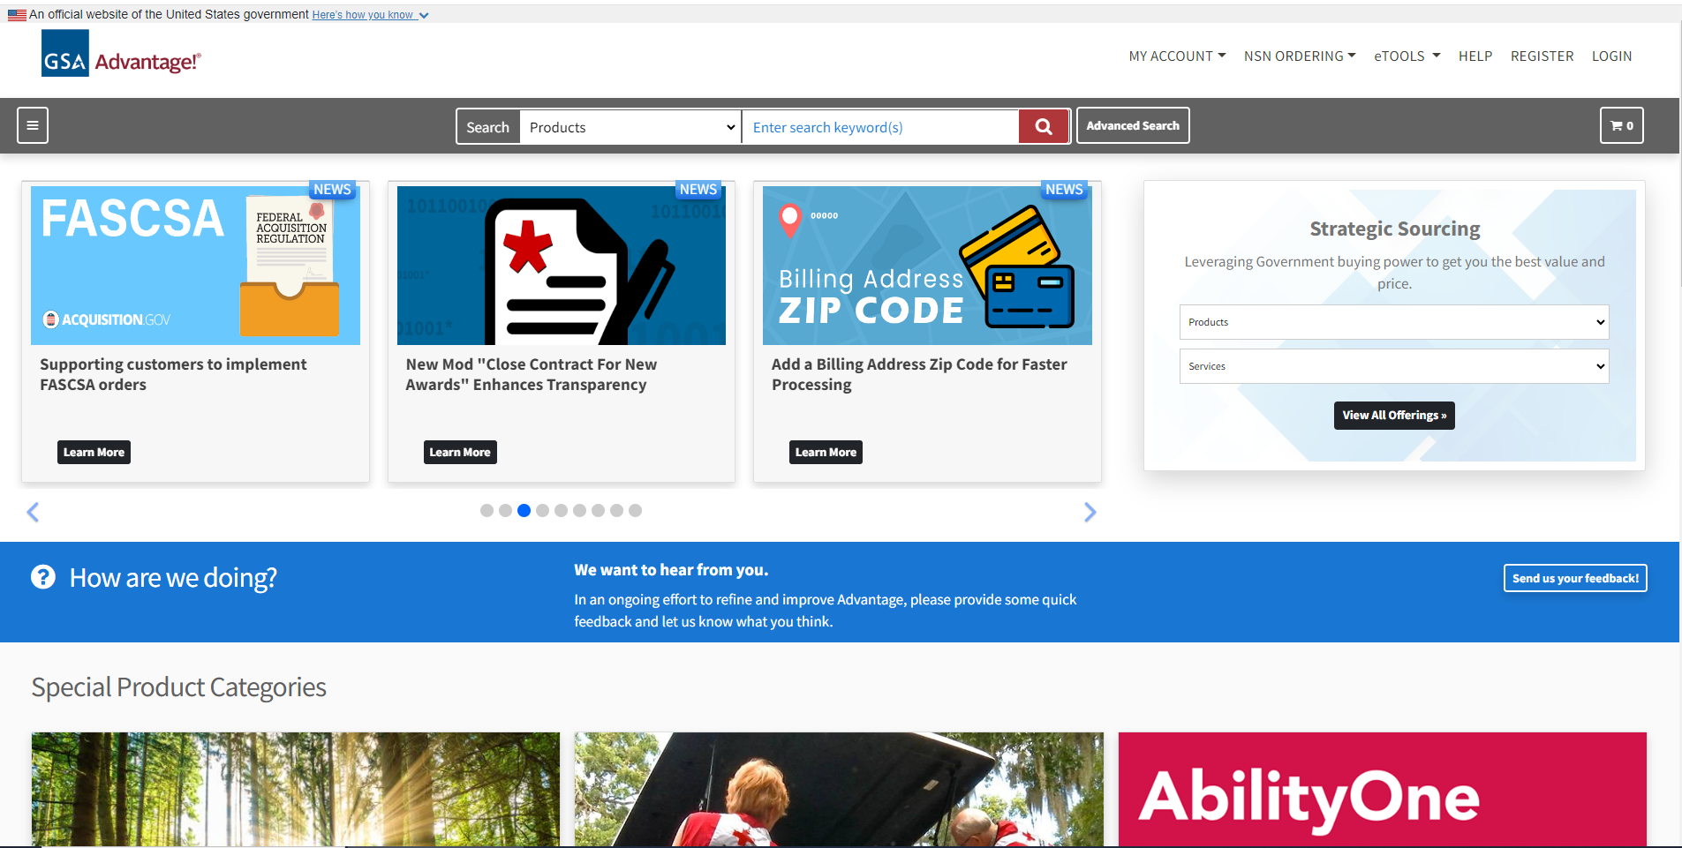
GSA IT Solutions Continued
https://www.gsaadvantage.gov/advantage/

Slide 6
Global Supply
GSA Global Supply is a federal program administered by the General Services Administration. It is a requisition-based supply program for customers worldwide, including the DoD. Customers can use a variety of ordering mechanisms to submit requisitions to GSA for delivery globally.
We make it easy for our military and civilian customers to find and buy products. Customers benefit from leveraged pricing and administrative savings because GSA has already completed a competitive procurement process for each item. GSA also ensures compliance with FAR, AbilityOne mandates and other relevant purchasing regulations.
While Global Supply does work with commercial suppliers to develop its product line, customers purchase from GSA. Each transaction is government-to-government (G2G). It is a priority source when federal agencies and military users are purchasing supplies, per FAR section 8.002.
GSA Global Supply offers easy access to common-use items, including:
Maintenance, repair and operations
Janitorial and sanitation
Office supplies

Slide 7
Federal Purchasing Programs
https://www.gsaglobalsupply.gsa.gov/advantage?store=FSS

Slide 8
eLibrary
GSA eLibrary is your one source for the latest GSA contract award information. GSA offers unparalleled acquisition solutions to meet today's acquisition challenges. GSA's key goal is to deliver excellent acquisition services that provide best value, in terms of cost, quality and service, for federal agencies and taxpayers.
Multiple Award Schedule (MAS) & VA Schedule
Blanket Purchase Agreement (BPA) – (i.e., 2GIT Products)
Indefinite-Delivery, Indefinite Quantity (IDIQ) – (i.e., BMO, HCaTS, OASIS)
Governmentwide Acquisition Contracts (GWACs) – (i.e., 8a Stars III, Alliant 2, VETS 2)
Network Services & Telecommunications – (i.e., CS3, EIS)
https://gsaelibrary.gsa.gov/ElibMain/home.do

Slide 9
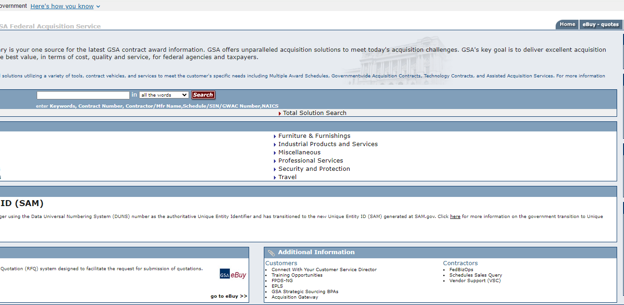
GSA eLibrary
http://gsaelibrary.gsa.gov/ElibMain/home.do

Slide 10
buy.gsa.gov
The federal acquisition community has been asking for a simpler way to get the information it needs to make smarter purchases while saving taxpayer dollars for years, buy.gsa.gov your new starting point for all things federal buying. This buyer experience tool was built using human-centered design to address pain points in the acquisition process. It features a governmentwide effort resulting from user research and usability testing sessions that included federal agencies, vendors, and GSA's own acquisition professionals.
This website is designed to make it easier for Government agency customers to navigate the complete acquisition process, and Industry to bring needed supplies and services into the federal marketplace:
Easier Market Research
Simplify how you conduct market research, find contract vehicles and vendors, and meet mission requirements or Small Business Administration targets
Documents, Templates, and Pricing Resources
Get searchable templates and sample documents that help you plan your acquisition
Interactive Checklist
Build your acquisition package with our new easy to use interactive checklist with self-help modules

Slide 11
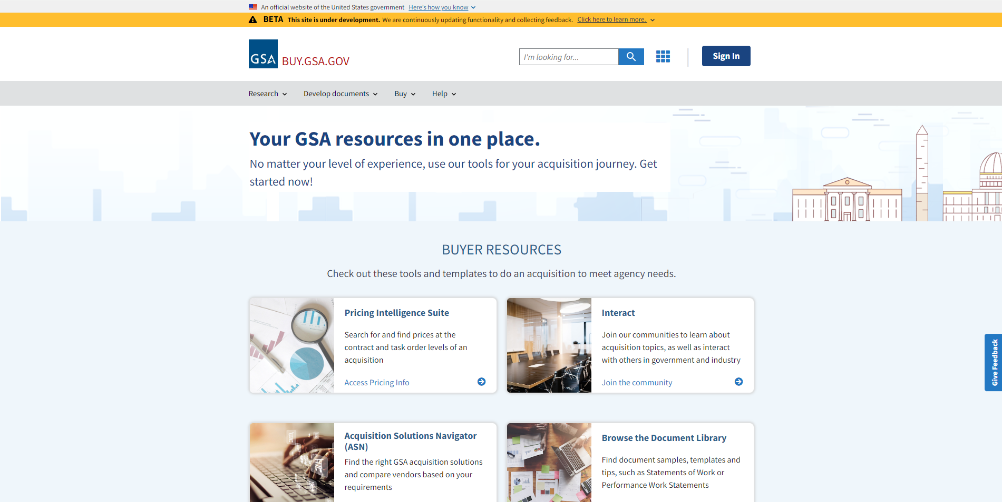
GSA buy.gsa.gov
https://buy.gsa.gov/

Slide 12
Live Demo
Notes:
Ryan/Andrea
Andrea will share screen during live demo
QASP 1: USPTO Sample - https://hallways.cap.gsa.gov/app/#/doclib?filter%5Btype%5D%5B0%5D=1773&document=78388
This one is basic but good
Shows basic elements of QASP
Doesn’t show actual performance metrics
QASP 2: Army Contracting Command Template - https://hallways.cap.gsa.gov/app/#/doclib?filter%5Btype%5D%5B0%5D=1773&document=4380
This is a template
Good resource if you want to use it
Can build off of it
Allows you to reuse multiple times
Again non-specific
Important again to note that like last time, creates special section for performance measurements
QASP 3: NASA QASP for Software - https://buy.gsa.gov/docviewer?id=1931&docTitle=nasa%27s%20quality%20assurance%20plan%20for%20software&docType=112
UTM Link for Kelly Chat: https://buy.gsa.gov/docviewer?id=1931&doctitle=nasa%27s%20quality%20assurance%20plan%20for%20software&doctype=112?utm_campaign=atrw_fall2023&utm_medium=referral&utm_source=zoom
Most specific QASP example yet
Love the key abbreviations list
Structured nicely with table of contents, makes it easier to read despite length
Details organizational structure
Details more of the evaluation and review criteria
Would love to see an attachment that includes the review and criteria sheet to see how it is laid out
But, we can take best practices from all three and combine them
Goes to show how general and QASP can be, but it must fit your acquisition needs

Slide 13
Additional Resources to Conduct Research
Acquisition Gateway – official online platform for government acquisition programs, policies, initiatives and tools connecting acquisition professionals and federal buyers with the information and resources to improve acquisition government-wide (https://www.acquisitiongateway.gov/)
Buyer Resources - tools and templates to do an acquisition as well as help you buy the products and services you need (https://buy.gsa.gov/buyer-resources?tab=research)
eBuy Open - access to all electronic from 48K+ posted RFP/Qs since FY2016 for real-time PWS/SOO/SOWs (https://www.ebuy.gsa.gov/ebuyopen/)
Find Samples, Templates & Tips - sample documents and ordering guidance that can help you write requirements, prepare your acquisition package, and/or execute your contract (https://buy.gsa.gov/find-samples-templates-tips?page=1&sort_by=title&sort_order=asc)
MAS SIN to NAICS Code Crosswalk (https://gsaelibrary.gsa.gov/docs/MAS_Available_Offerings_Attachment_Refresh.xlsx)

Slide 14
GSA Point of Contact
What is a CSD? https://youtu.be/TJNXlBOsCXg
Find your agency point of contact - https://www.gsa.gov/about-us/organization/federal-acquisition-service/customer-and-stakeholder-engagement/find-your-agency-point-of-contact

Slide 15
Questions?

Slide 16
GSA Starmark Logo

Slide 17
ThankYou!
Office of Integrated Marketing

