Slide 1


Emergency Acquisition Survival Skills
Office of Integrated Marketing
July 18, 2024

Slide 2


Presenters
Reagan Criddle
Deputy Director, Emergency Acquisitions
Office of Acquisition Operations
Mark King
Customer Service Director, NASA Accounts
Office of Customer and Stakeholder Engagement

Slide 3
Office of Acquisition Operations
presented by
Reagan Criddle
Emergency Acquisition Basic Ordering Agreements

Slide 4
Who we are
  The Office of Acquisition Operations falls under GSA’s Federal Acquisition Service (FAS).
  FAS’s mission is to provide an exceptional customer experience by delivering best value goods and services through an increasingly digital environment.
Who we support
  Primarily we support other Federal agencies.
Introduction

Slide 5
Explain what BOA’s are, how they work, and who can use them
Discuss the Emergency Acquisition (EA) Basic Ordering Agreements (BOA’s)
Review the scope of the EA BOA’s along with the benefits of using them
Ordering Process and Example Requirements
Summary & Data
Q&A
Agenda

Slide 6
Federal Acquisition Regulations (FAR) 16.703 (emphasis added)
BOA’s are written instruments of understanding, negotiated between an agency, contracting activity, or contracting office and a contractor, that contains (1) terms and clauses applying to future contracts (orders) between the parties during its term, (2) a description, as specific as practicable, of supplies or services to be provided, and (3) methods for pricing, issuing, and delivering future orders under the basic ordering agreement. A basic ordering agreement is not a contract.
BOA’s are effective instruments for expediting contracting activities for uncertain requirements in which specific quantities, items, and prices are not known at the time of execution of the agreement.
Basic Ordering Agreements

Slide 7
BOA’s were initially considered to assist GSA with rapidly procuring supplies and services in support of FEMA. During Acquisition Planning and market research, it became clear these vehicles could also offer value to other Federal agencies in times of emergency.
  These BOA’s may be used, free of charge, by all Federal agencies.
GSA executed 19 BOA’s with vendors from diverse industries and locations to ensure FEMA and other Federal agencies would have a pool of experienced and capable vendors to procure commercial supplies and services from in times of emergency.
  Of the 19 BOA’s executed, 15 of the vendors are Small Businesses.
GSA’s EA Basic Ordering Agreements

Slide 8
EA BOA’s may be used to rapidly procure just about any commercial supply or service, so long as the requirement is in support of an emergency.
  The EA BOA definition of emergency is broader than that found in the FAR which requires a Presidential declaration.
  The term “Emergency” used within this agreement means events which meet the definition found in FAR 2.101 OR any situation which, if not corrected immediately, will result in unnecessary expenditure of funds, property damage, personal injury, or interruption of agency functions.
If a given requirement is determined an emergency by an agency, or a Presidential declaration is made, your requirement for commercial supplies or services is likely within the scope of this BOA.
  Should there be questions about scope or use of these BOA’s, contact the EA BOA Contracting Officer (see Contacts slide).
Scope

Slide 9
Easy to use
Flexible to unique situations and buyers
Competitive without sacrificing quality or time
No price lists or item catalogs
Rapid solicitation, response, and delivery timeframes
Benefits

Slide 10
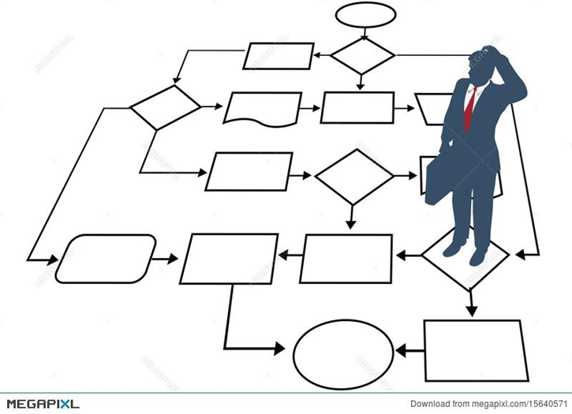
Identification of need
Describe/Define requirement
Market Research & Acquisition Planning
Review & Approval
Draft solicitation
Review & Approval
Publish/distribute solicitation
Evaluate quotes/offers
Draft award decision
Review & Approval
Send order/contract to awardee for signature
CO countersigns award document
Distribute award to awardee
Publish award notice
Typical Acquisition Process Flow

Slide 11
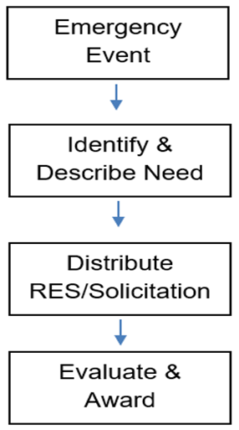

GSA has already performed the market research, acquisition planning, and responsibility determinations to streamline ordering procedures for users.
The BOA was synopsized through SAM.gov and provided fair opportunity.
Authorized users may jump right into their solicitations after they have identified their emergency requirement and adequately described their need.
Rapid response times, evaluation procedures, and delivery terms are present in the BOA allowing streamlined competition and awards.
EA BOA Process Flow

Slide 12
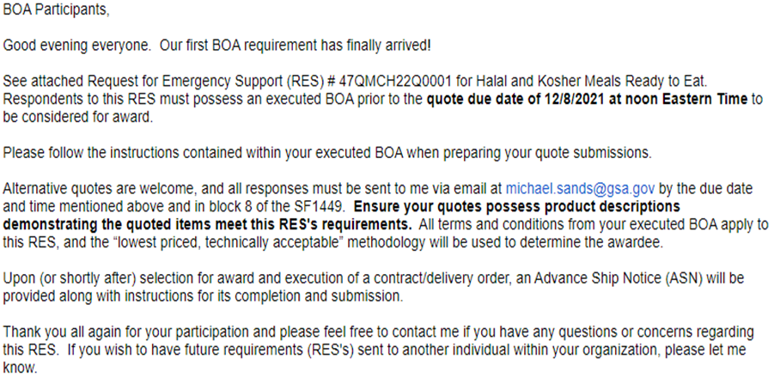
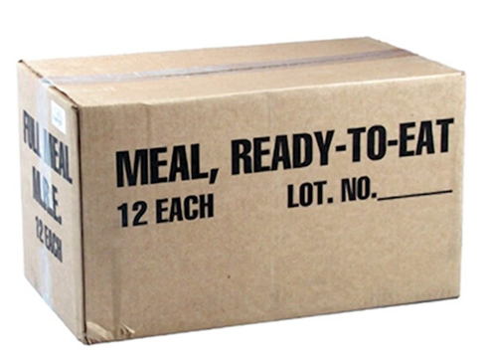
Example Requirement
Example Requirement

Slide 13
GSA’s EA BOA’s offer a streamlined approach to commercial purchases during emergencies.
Any Federal agency can use, free of charge.
No price lists or item catalogs
The EA BOAs have been used to rapidly purchase meals, COVID test kits, sheltering items, Joint Field Office (JFO) kits, and pandemic kits.
Average savings of ~39% in FY23 and ~32% in FY22
Competitive process (>5 quotes received on all GSA solicitations)
Summary & Data

Slide 14
https://www.acquisition.gov/far/part-16#FAR_16_703
A copy of the BOA and Master Contact List of BOA Participants may be found at the link below:
https://www.gsa.gov/governmentwide-initiatives/emergency-response/emergency-acquisition-basic-ordering-agreements
EA BOA Contracting Officers:
Reagan Criddle, 312-208-4834, reagan.criddle@gsa.gov
Michael Sands, 786-795-3259, michael.sands@gsa.gov
References & Contacts

Slide 15
Questions?

Slide 16
Office of Customer Accounts and Stakeholder Engagement
presented by
Mark King
GSA MAS and Emergency Solutions

Slide 17

Multiple Award Schedule (MAS) Overview
  MAS Structure and Benefits
  Purchasing Resources and Support for State and Local Governments
Essential Survival Skills:
  Survival Skill #1: Cooperative Purchasing Program and Security and Protection Offerings
  Survival Skill #2: Disaster Purchasing and related products and services
  Survival Skill #3: Federal Grantee Access To Schedules in Response to Public Health Emergencies
Agenda

Slide 18

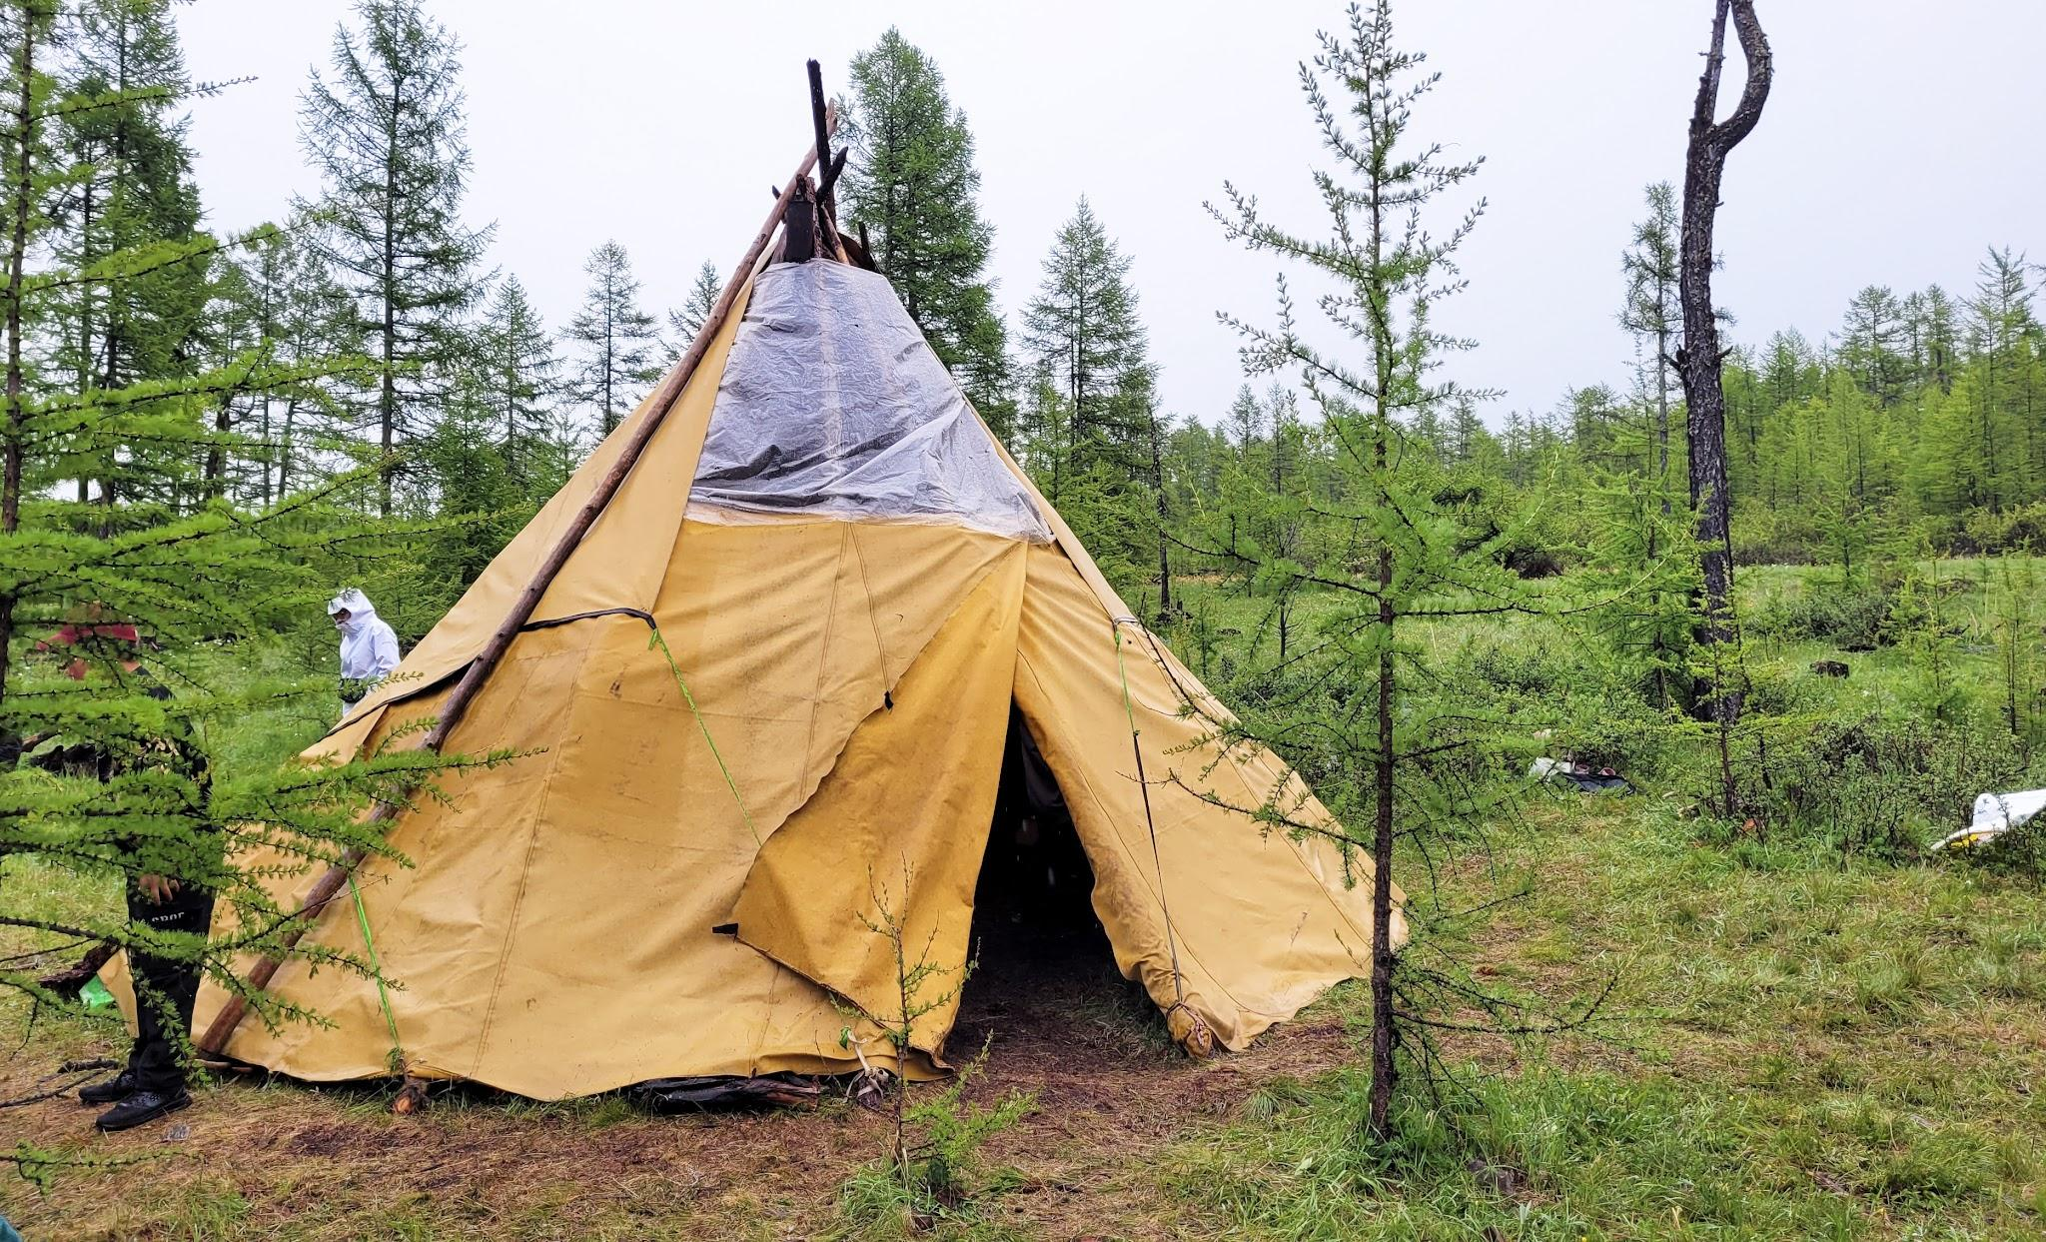
Why Use a GSA Schedule Contract?
Versus
Build a contract from scratch
Use an already existing contract vehicle

Slide 19

Indefinite Delivery, Indefinite Quantity (IDIQ) Contracts
Five year base period with three, five-year option periods
Streamlined procedures to increase acquisition speed
Access to small businesses to support socioeconomic goals
FAR compliance
Pre-qualified/Vetted Contractors
Pre-negotiated ceiling prices (determined fair and reasonable) to achieve best value
Access to emerging technologies and innovative solutions
Price quoted is the price paid (Industrial Funding Fee already included)
Overview of Multiple Awards Schedule (MAS) Contracts

Slide 20
Cooperative Purchasing Program
Disaster Purchasing Program
Public Health Emergency (PHE)
1122 Program
Purchasing Resources and Support for State and Local Governments:

Slide 21

Eligible Users
The 50 states
All counties
Municipalities, cities, towns and townships
Tribal Governments
Public Authorities (Public or Indian Housing agencies under the U.S. Housing Act of 1937)
School districts
Colleges or any instrumentality thereof
Eligibility

Slide 22

The Cooperative Purchasing Program allows state, local, and tribal governments to purchase IT, security, and law enforcement products and services offered through specific Schedule contracts. Cooperative Purchasing allows eligible entities to purchase from approved industry partners, at any time, for any reason, using any funds available.
Cooperative Purchasing:

Slide 23

GSA's Disaster Purchasing Program allows state and local governments to buy supplies and services directly from all GSA Schedules to facilitate disaster preparation, response, or major disaster recovery. Purchases made in support of recovery must be in response to a Stafford Act Presidential declaration. The Federal Emergency Management Agency (FEMA) manages the list of declared disasters
Disaster Purchasing Program:

Slide 24

Under the GSA PHE program, these non-federal entities are authorized to buy from all Schedules when spending federal grants funds in direct response to PHEs. This authorization was granted by the GSA Administrator in conjunction with the Secretary of Health and Human Services, under section 319 of the Public Health Services Act, codified at 42 U.S.C. § 247d.
Public Health Emergencies:

Slide 25
Survival Skill #1:
Cooperative Purchasing Program and the Security and Protection Offerings

Slide 26
The two authorities for the Cooperative Purchasing program are:
  Public Law 107-137: Section 211 of the e-Gov Act of 2002.
  Public Law 110-248: Local Preparedness Acquisition Act.
All fifty (50) states, counties, municipalities, cities, townships, Tribal Governments, Public Authorities (Public or Indian Housing agencies under the U.S. Housing Act of 1937), school districts, and colleges or any instrumental thereof.
Cooperative Purchasing Authorization

Slide 27


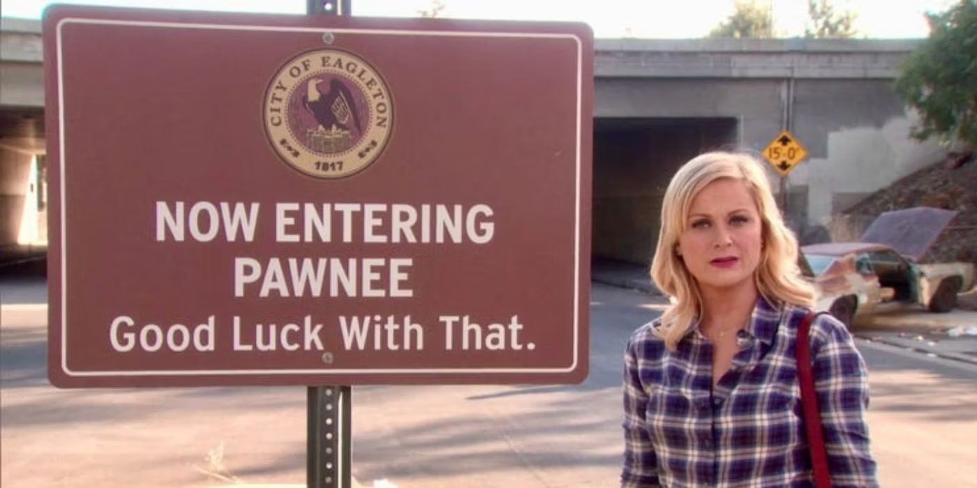
Is the City of Pawnee - Parks and Recreation Department eligible to purchase off of GSA Schedules?
Yep
“Knope”
Eligibility Quiz!

Slide 28



Marine Craft & Equipment
  Patrol Boats
Firefighting & Rescue Equipment
  Helicopters
Alarm/Facility Management Systems & Protective Service Occupations
  Physical Access Control Systems (PACS)
  Guard Services
  UAS (drones)
Special Purpose Clothing
Law Enforcement & Security Equipment /Services
  Body Worn Cameras (BWC)
  Drug Testing Services
Snapshot of Offerings

Slide 29

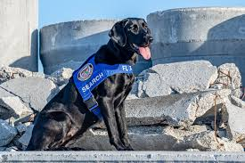
SIN 812910 - Canine Training, Handling and Caging Products & Services
(***including search and rescue)
Canine Training and Handling

Slide 30
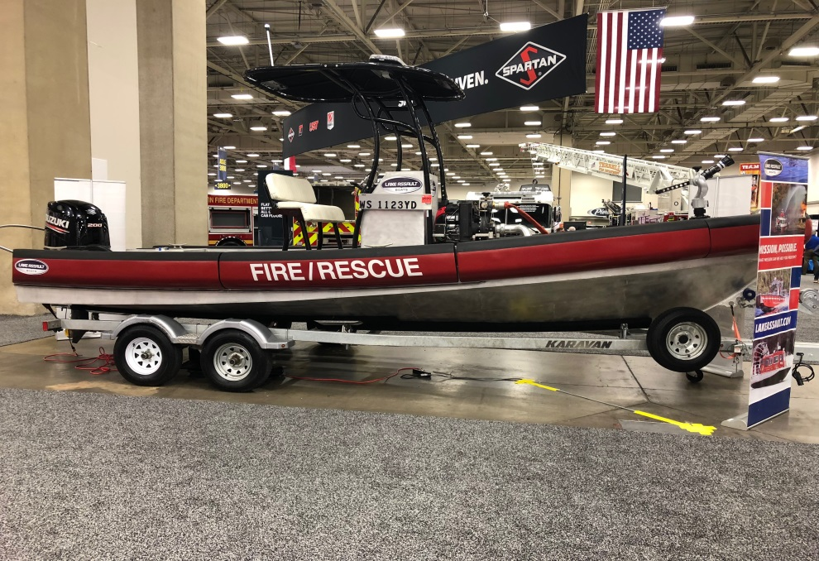
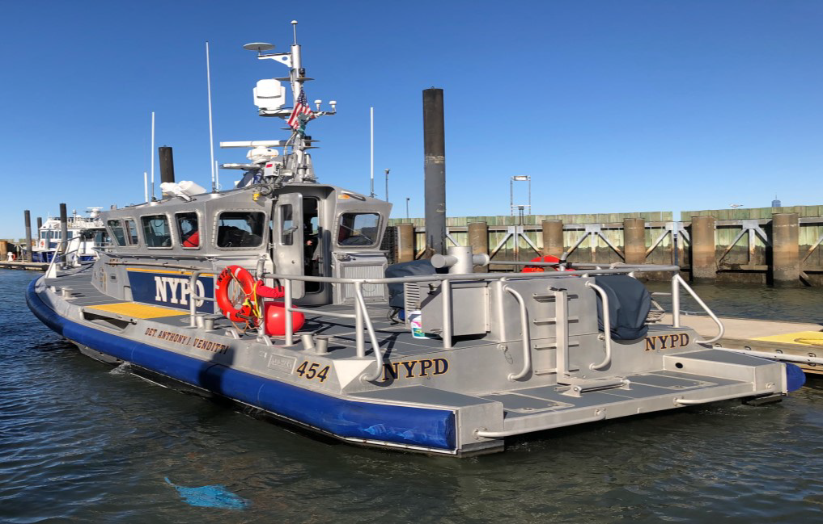
REAL WORLD Examples:
Marine and Patrol Boat Purchases
City of Waco, TX Purchase
NYPD Purchase

Slide 31


City of Houston PD
H-125 Airbus via Davenport Aviation
$7.5M, Delivered December 2020
Honoring Officer Jason Knox
REAL WORLD Examples:
Houston PD Helicopter

Slide 32
Survival Skill #2:
Disaster Purchasing Program

Slide 33


Between January 2013 and January 2023, 88.5% of all U.S. counties declared a natural disaster
In 2022, the U.S. experienced 18 climate disasters that caused over $1 billion in damage. These 18 weather disasters cost the country ​​$175.2 billion in damage and resulted in 474 fatalities.
Frequency over the past decade:
  Severe Storms: 99
  Tropic Cyclones: 24
  Flooding: 17
  Droughts: 10
  Wildfires: 9
Natural Disaster Facts

Slide 34
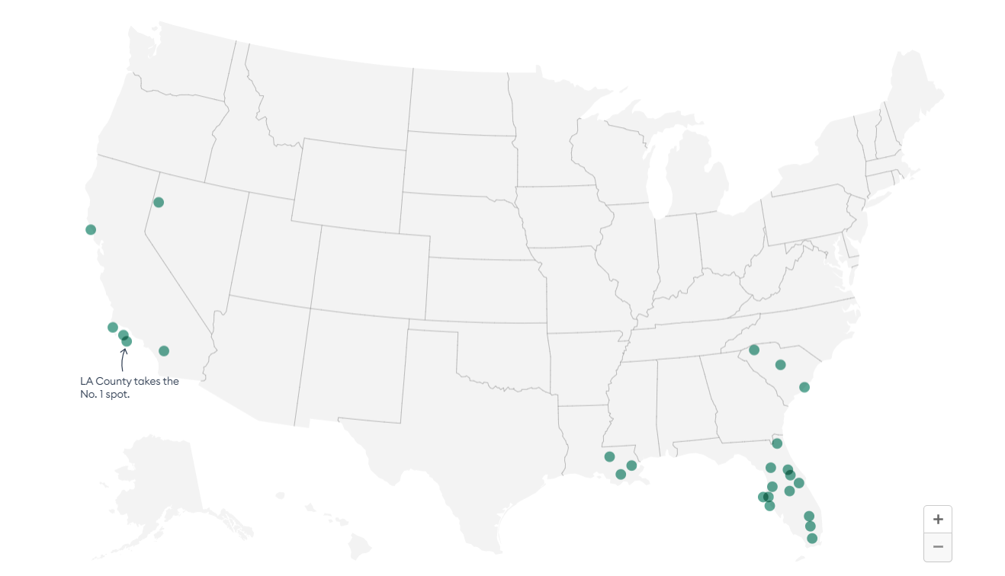
Top 25 Most Disaster-Prone Counties

Slide 35
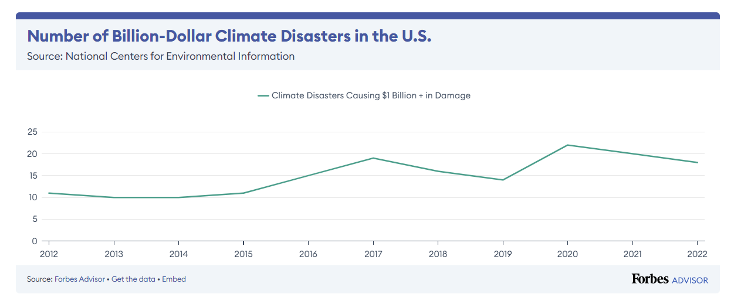
Number of Billion-Dollar+ Climate Disasters in the U.S.

Slide 36
SCOPE
This program authorized State and Local governments’ access to ALL Federal Supply Schedules, when purchasing to facilitate disaster preparation and response or recovery from major disasters
DEFINITIONS
Preparedness
Response
Recovery
Disaster Purchasing Program

Slide 37
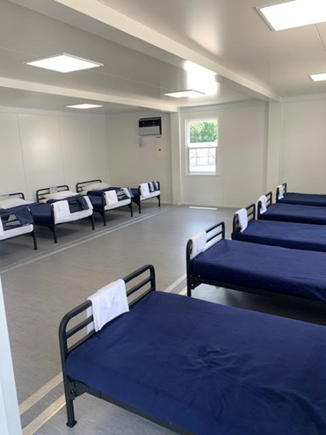
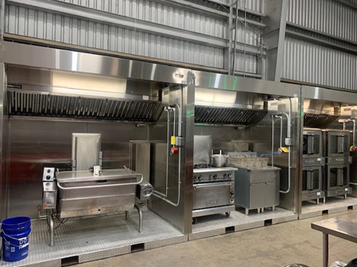
Anything needed to help prepare for, respond to, or recover from an emergency, to include, but not limited to:
Cots and Blankets
Water and Meals
Tarps and Plastic Sheeting
Generators
Hygiene kits
Debris removal services
Temporary shelters and prefabricated structures
Emergency lodging services (BPA)
Disaster Purchasing Program

Slide 38
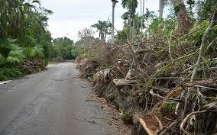

Customer: Galveston TX
What: Debris Removal Services BPA
REAL WORLD Examples:
Disaster Purchasing Survival Skills

Slide 39


Personal Property Donation
Customer: City of Baytown, TX
What: Kennels via GSAXcess
From Who: Lackland AFB in San Antonio
REAL WORLD Examples:
Disaster Purchasing Survival Skills

Slide 40
Survival Skill #3:
Public Health Emergencies

Slide 41


Federal Grantee Access to Schedules in Response to Public Health Emergencies allows access for State & Local government to purchase supplies and services when expending federal grants funds in response to Public Health Emergencies.
A public health emergency must be declared by the Secretary of Health and Human Services under section 319 of the Public Health Services Act, codified at 42 U.S.C. § 247d.
Public Health Emergencies (PHE)

Slide 42


Anything related to resolving a public health crisis to include but not limited to:
  Personal Protection Equipment (masks, gowns, gloves)
  Cleaning supplies
  Hand sanitizer
  Medical equipment
Public Health Emergencies (PHE) Offerings

Slide 43

GSA Local Customer Service Directors
GSA State and Local Programs
Cooperative Purchasing SINs
Public Health Emergency Declarations
Surplus Federal Property
Emergency Lodging Services BPA
BUY.GSA.GOV
Resources and Contacts:

Slide 44
Questions?

Slide 45
Thank You!
Office of Integrated Marketing

