Slide 1


Trailblazing the Path: A Guide to Performance-Based Acquisitions
Office of Integrated Marketing
July 19, 2024

Slide 2

Presenter
Jonathan Evans
CSAW Program Manager & Senior Facilitator
Office of Professional Services & Human Capital Categories
GSA Federal Acquisition Service

Slide 3
Training Overview
Overview of Performance Based Acquisition
1
Definition of SOW, SOO, & PWS
2
Difference Between Document Types
3
Advantages & Disadvantages of Each
4
Writing Better Requirements
5
Q&A
6
2

Slide 4
Performance Based Acquisition

Slide 5
What is PBA?
"Performance-based Acquisition" (PBA) means an acquisition structured around the results to be achieved as opposed to the manner by which the work is to be performed. - FAR 2.101
Notes:
Requirements are set forth in clear, specific, and objective terms with measurable outcomes
Does not state HOW the work is to be performed or have a broad and imprecise statement of work
Use of the word "acquisition" rather than "contracting" reflects the broader scope (from mission planning through contract closeout) and the broader community (including program offices) that are a necessary part of the process.

Slide 6

Compliance
Performance Based Acquisition is the preferred method for acquiring services
Agencies must use PBA methods to the maximum extent practicable
FAR 37.102(a)(1)

Slide 7




4 KEY ELEMENTS OF PBA
Uses a Performance Work Statement (PWS) or Statement of Objectives (SOO)
Includes measurable performance standards for all performance requirements
Provides appropriate incentives to drive higher performance and/or promote innovation
Utilizes a Quality Assurance Surveillance Plan (QASP) to define how the contract will be monitored (see FAR 46.4)

Slide 8








STEPS TO PERFORMANCE BASED ACQUISITION
STEP 1
Form the Team
STEP 2
Identify Objectives
STEP 3
Market Research
STEP 4
Define Requirements
STEP 5
Define Measures
STEP 6
Source Selection
STEP 7
Manage Performance
STEP 8
Complete Closeout
PURPOSE: Establish the team and conduct high-level project planning. | PURPOSE: Identify why we’re doing this in the first place and what are the high-level objectives (HLO). | PURPOSE: Take a team approach to market research using available tools and innovative resources. | PURPOSE: Develop well-written requirements statements and identify the appropriate work statement type. | PURPOSE: Define what constitutes successful performance and how the team will measure this? | PURPOSE: Review options for evaluation criteria and think through the source selection process. | PURPOSE: Manage the contract to ensure performance objectives are met. | PURPOSE: Plan for closing out the contract and concluding the project.
Notes:
https://pba.app.cloud.gov/app/#/pba
https://buy.gsa.gov/spba

Slide 9
Definition of SOW, PWS & SOO
Notes:
Definition of SOW, PWS & SOO
Advantage and disadvantage of each

Slide 10
Definition of SOW, PWS & SOO
Statements of Work (SOW), Performance Work Statements (PWS), and Statements of Objectives (SOO) are different types of requirement documents that explain the needs of the government.
Notes:
--------------------------------------------
Difference between the SOW SOO, and PWS
SOW = defines exactly how and when the contractor will carry out the requirement and tasks within
PWS = describes work in terms of “required outcomes” measurable results, using clear, precise, and objective terms
SOO = provides the objectives that the gov’t is looking to achieve but does not address the required tasks the contractor is to perform

Slide 11
Definition of SOW
STATEMENT OF WORK (SOW)
A SOW specifies the processes and methods the contractor must use when executing the planned work. This type of requirement document is designed to describe not only what must be done, but also how it must be done. An SOW is prescriptive and restrictive by nature.
The SOW is incorporated into the contract.
Notes:
The FAR does not define SOW
SOW describes the work and how to perform

Slide 12
Definition of PWS
PERFORMANCE WORK STATEMENT (PWS)
A PWS describes the work in terms of required results rather than either “how” the work is to be accomplished or the number of hours to be provided and gives the contractor flexibility to devise the best method to accomplish the required result.
The PWS is incorporated into the contract.
Notes:
FAR 2.101 Definitions
Performance work statement means a statement of work for performance-based acquisitions that describes the required results in clear, specific and objective terms with measurable outcomes.
Performance-based acquisition (PBA) means an acquisition structured around the results to be achieved as opposed to the manner by which the work is to be performed.

Slide 13
Definition of SOO
STATEMENT OF OBJECTIVES (SOO)
A SOO establishes a broad description of the government’s overall goal(s) for the requirement as well as High Level Objectives and performance objectives. It focuses on the outcomes rather than on how the work is to be done. It is used when the Government intends to provide the maximum flexibility to each offeror to propose an innovative approach.
The SOO is NOT incorporated into the contract.
Notes:
PWS is proposed from SOO
SOO is Gov Document

Slide 14
Differences in Work Statements

Slide 15
Difference between the SOW, PWS, & SOO
SOOs provide broad statements of the agency’s High Level Objectives but leaves the solution entirely up to the contractor to propose.
  Stop the spread of COVID -19 in the US
  Ensure no NEW infections After X/XX/2020
  Ensure a decline of New COVID -19 cases
  Keep officials and the public informed
PWSs can also have HLOs or sub-objectives but with some guidelines or specifications and often listed as “tasks.”
  Test 5000 people per day
  Continuously share progress with state Public Health officials
SOWs are “prescriptive” they tell the contractor what to do and how.
  Implement drive though COVID Testing
  Use Thermal Thermometers to test each participant
  Create a Dashboard to continuously share progress with state Public Health officials”
15
Notes:
SOO = What RESULTS does the government want
PWS = WHAT does the government want
SOW = WHAT does the government want and HOW does it want it done. (Like a prescription tells you; what to take, how many to take, when to take them, and sometime what to take them with i.e. food)
different types of requirement documents that explain the needs of the government.

Slide 16
Advantages & Disadvantages

Slide 17
Advantages & Disadvantages of SOWs
An SOW is prescriptive and restrictive by nature. It provides detailed descriptions of the work to be performed, telling the contractor exactly what to do and how to do it.
Advantages:
By describing the work in such detail, the government essentially;
provides the preferred approach or solution to the problem,
and locks in the approach the contractor must take.
Disadvantages:
SOWs requires the contractor to follow the government’s approach.
If the contractor follows the government’s approach and the result is unacceptable, the government has no recourse.
Many SOWs are so broadly written that not enough detail is provided to the contractor to appropriately bid.
Tendency to limit competition and result in incumbency
You cannot have a Performance Based Acquisition if you use a SOW
17
Notes:
--------------------------------------------
The SOW is designed to describe what is to be done, but also how it is to be done. “Here’s what we want, here’s how you will do it, and here’s how you’re going to deliver it.”
SOW is written to identify the job and direct the contractor specifically how to do it “Broadly written” SOWs are NOT “SOWs”.
A Scope of Work can be broadly written (Lawn maintenance for the grounds and golf course), A Statement of work – Specifies… (Mow lawn at dusk, using energy saving equipment, cut golf locations to 1 inch, all other areas must be 2.5 inches.
If your SOW is too broadly written what you likely have is a PWS without any performance standards… your CO will keep asking “What are you buying?” “What does DONE look like”? How will you/COR know that performance is progressing well”? How will you measure good or bad performance” “What does good/bad performance look like? “How will you know the job is well done at then end?
Must vs must not - Have to follow

Slide 18
Advantages of a PWS
A PWS is a requirement document for Performance-Based Acquisitions that describes the required results or outcomes.. The PWS has two mandatory features:
It articulates the government requirement in clear, specific and objective terms of outcomes or results, rather than methods of performance
It identifies measurable performance and a method for assessing contractor performance, outcomes, and deliverables.
Advantages
Focuses on measurable performances, outcomes and deliverables.
PWS can be prepared by the Government OR result from a SOO issued by the Government where the offeror responds by proposing a PWS.
Allows the government to evaluate and select distinct solution/ proposals that address the governments requirements.
Enables assessment of contractor performance against measurable standards.
Encourage competitors to develop and institute innovative and cost-effective methods of performing the work.
18
Notes:
--------------------------------------------
“Performance-based acquisition (PBA)” means an acquisition structured around the results to be achieved as opposed to the manner by which the work is to be performed. (PWS & SOO)
While SOOs have high level objectives, “Stop the spread of CODID -19 in the US to ensure no NEW infections After 4/15/2020 “, (This is both an objective and a performance measure) “Ensure the continued decline in New COVID -19 cases”
PWSs can also have HLOs or sub-objectives that are often listed as tasks Test 5000 people per day (objective and Measure)
Continuously share progress with state Public Health officials” SOWs tell the offerors how to achieve the HLO “Implement drive though COVID Testing”
Use Thermal Thermometers to test each participant
37.603 Performance standards.
(a) Performance standards establish the performance level required by the Government to meet the contract requirements. The standards shall be measurable and structured to permit an assessment of the contractor’s performance.
(b) When offerors propose performance standards in response to a SOO, agencies shall evaluate the proposed standards to determine if they meet agency needs.
37.604 Quality assurance surveillance plans.
Requirements for quality assurance and quality assurance surveillance plans are in subpart 46.4 . The Government may either prepare the quality assurance surveillance plan or require the offerors to submit a proposed quality assurance surveillance plan for the Government’s consideration in development of the Government’s plan.

Slide 19
Disadvantages of a PWS
Disadvantages
Preparing a PWS requires a team based approach to develop (including program office, contracting, SMEs, requirements owners), which is often difficult to get agency support to pull together.
It can be challenging to establish performance requirements, develop performance standards, write the performance work statement, and producing the quality assurance surveillance plan.
The government has to devise performance measures that apply directly to the required outcomes/deliverables, These performance measures need to accurately and adequately evaluate the contractors performance with regards to required deliverables and results.
19
Notes:
--------------------------------------------
(see 11.002(a) (2) and 11.101);
11.101 Order of precedence for requirements documents.
(a) Agencies may select from existing requirements documents, modify or combine existing requirements documents, or create new requirements documents to meet agency needs, consistent with the following order of precedence:
(1) Documents mandated for use by law.
(2) Performance-oriented documents (e.g., a PWS or SOO). (See 2.101.)
(3) Detailed design-oriented documents.
(4) Standards, specifications and related publications issued by the

Slide 20
Advantages of a SOO
A SOO is a government prepared document that provides basic, high-level objectives (HLOs) of the requirement and states the overall performance objectives. A SOO would provide broad and less detailed description of the requirement.
Advantages:
Provides potential offerors maximum flexibility to develop cost-effective innovative solutions and the opportunity to propose alternative approaches to meeting the Government’s objectives.
Industry is able to apply its knowledge and experience to craft the most effective and possibly innovative solution.
Enables the government to better assess the offerors’ understanding of the requirement by eliminating the “how to” instructions normally contained in the SOW and PWS the government
Requires contractors to submit their solution as a PWS. This eliminates the need for the government to perform detailed analyses usually required to produce a PWS.
20
Notes:
--------------------------------------------
SOO is a Government-prepared document – only requirement doc that has to be written by the gov. Think of a SOO and a problem statement where industry proposes the solution.
requires competing contractors to develop (and submit with their offer/ proposal) the PWS, performance metrics and a measurement plan, and a quality assurance plan, all of which should be evaluated before contract award
When you write a “broad scope” or “broad SOW” but aren’t requiring contractors to respond with a PWS and other documents, you are essentially using the SOO process but have not bought or required anything concrete from the vender.

Slide 21
Advantages of a SOO, cont…
The contractor developed PWS will include necessary tasks to be performed for each outcome/objective.
Offerors can (SHOULD) be required to submit performance standards and a Quality Control Plan (QCP) along with the PWS.
The PWS, performance measures, and QCP will be incorporated into the award.
  NOTE: The Quality Assurance Surveillance Plan (QASP) – a government-owned document – should not be incorporated into the contract.
The government can get a requirement on the street with a SOO faster than the other methods.
9
Notes:
--------------------------------------------
FAR 37.604 authorizes an agency to require offerors to propose QASPs as part of their response to the solicitation (PWS & SOO )
When a solicitation requires offerors to propose a QASP, the government CO should insert a caveat indicating “the government may or may not use any or all of the proposed QASP, and may or may not revise the QASP at any time during contract performance to reflect emerging in formation, performance issues, or priority

Slide 22
Disadvantages of a SOO
Disadvantages
The evaluation process will be more time consuming. The government will not be comparing Apples to Apples. Agencies should identify the format offerors must submit in the solicitation. Identifying the format helps the evaluation and source selection process.
The IGE won’t be readily determinable prior to receiving offers. The solicitation should provide a ceiling so that contractors get a better understanding of size and scope.
9
Notes:
--------------------------------------------
FAR 37.604 authorizes an agency to require offerors to propose QASPs as part of their response to the solicitation (PWS & SOO )
When a solicitation requires offerors to propose a QASP, the government CO should insert a caveat indicating “the government may or may not use any or all of the proposed QASP, and may or may not revise the QASP at any time during contract performance to reflect emerging information, performance issues, or priority

Slide 23
Deciding which work statement to use…

Slide 24
Which to Use & When to use?
Be honest about what you want and how much you know
Ask yourself how much you or your customer knows about your requirement?
1. A lot? How much of the risk does the PM/COR/CO want to take on vs Placing the risk of performance on the Contractor.
(potentially) Use a SOW when you
  Know every technical detail of your requirement,
  “How” the work must be done is essential to successful performance and
  Willing to assume the risk of project failure if you are wrong.
Use a PWS when you
  Do a performance based acquisition
  Have specific measures/standards necessary for successful performance and
  Have some guidelines or specific tasks that must be performed
Use a SOO when you
  Have a niche requirement and but have clear HLOs
  Know very little about technical inputs required for successful performance but have clear HLOs
  Don’t have the time, capacity, or in-house knowledge to develop a PWS and QASP
  Want to give industry the most flexibility to develop the solution
Notes:
Presenter
2020-03-12 14:26:25
--------------------------------------------
Each document can incorporate some aspects of another other. I like to think of a PWS as a SOO with Specifications.
SOO and PWS will need measurement standards/criteria- HOW will the government know/confirm that the RESULTs have been achieved, how will the contractor prove that the results have been achieved or that it performed WHAT the government asked it too? Recurring reports and status meetings are not “specific tasks”

Slide 25
Which to Use & When to use?
It depends….
If it is a follow-on, is it running smoothly?
  What makes it successful ? What issues exist and lessons learned?
  If unsuccessful? Which method was used? Would a different document significantly address the failures?
  You do not have to use the same method that was previously used.
  Use a PWS that also includes HLOs
    Tell the story of the failures in the background section. Be honest about what failed without pointing blame at the incumbent contractor.
    State what needs to be achieved in the Objectives Section
    State the performance standards that must be met
    Require a QCP and QASP/Service Level Agreement
Concerned that a high number of unqualified contractors might bid?
  Use a SOO. Make the Offerors (the industry experts) do the heavy lifting of explain HOW they will be carry out the work.
  This will eliminate unqualified bidders or make them much easier to spot during evaluations.
Notes:
Presenter
2020-03-12 14:26:25
--------------------------------------------
Each document can incorporate some aspects of another other. I like to think of a PWS as a SOO with Specifications.
SOO and PWS will need measurement standards/criteria- HOW will the government know/confirm that the RESULTs have been achieved, how will the contractor prove that the results have been achieved or that it performed WHAT the government asked it too?

Slide 26
Work Statement Formats

Slide 27
SOW Format
There is no specific template for an SOW many agencies use the following format:
Introduction – brief description of the agency’s mission
Objective – succinct statement of the purpose of the work or the desired end product
Scope of Work – broad, nontechnical sketch of the nature of the work required by the acquisition
Background – general description of the requirement
Type of Contract Contemplated
Period of Performance – or delivery date(s) for each key result or task; includes end results due dates, levels of effort if applicable, etc.
Place of Performance
Applicable Documents – specifications, required forms, etc.
Specific Tasks & Subtasks– Work to be done by the contractor usually in chronological order
Delivery or Deliverables – centralized compilation of all data and deliverable requirements of the contract, such as when (and how often), in what format and quantity, and to whom delivered; plus inspection and acceptance criteria. Usually provided as a table

Slide 28
SOW Format -
additional elements
The following sections are included in SOWs as applicable –
Meetings
Required Travel
Other Direct Costs
Special Instructions
Government Furnished Property/Equipment/Information

Slide 29
PWS Format
In accordance with FAR 37.602(b) Agencies shall, to the maximum extent practicable—
  Describe the work in terms of the required results rather than either “how” the work is to be accomplished or the number of hours to be provided;
  Enable assessment of work performance against measurable performance standards;
  Rely on the use of measurable performance environment to encourage competitors to develop and institute innovative and cost-effective methods of performing the work.
Notes:
Presenter
2020-03-12 14:26:26
--------------------------------------------
37.603 Performance standards.
(a) Performance standards establish the performance level required by the Government to meet the contract requirements. The standards shall be measurable and structured to permit an assessment of the contractor’s performance.
(b) When offerors propose performance standards in response to a SOO, agencies shall evaluate the proposed standards to determine if they meet agency needs. 37.604 Quality assurance surveillance plans.
Requirements for quality assurance and quality assurance surveillance plans are in subpart 46.4 . The Government may either prepare the quality assurance surveillance plan or require the offerors to submit a proposed quality assurance surveillance plan for the Government’s consideration in development of the Government’s plan.

Slide 30
SOO Format
There is no specific template for SOO’s
In accordance with FAR 37.602 (c) Offerors use the SOO to develop the PWS; however, the SOO does not become part of the contract. The SOO shall, at a minimum, include-
  Purpose;
  Scope or mission;
  Period and place of performance;
  Background;
  Performance objectives, i.e., required results; and
  Any operating constraints.
Notes:
Describe constraints - assumptions… BUT also ask vendors what assumptions they are making as well on their proposal

Slide 31
Proposal Characteristics
Government Creates | Vendor Proposal Characteristics
SOW | Technical Approach parrots the SOW Reviewers may not be able to distinguish between experienced offerors and opportunistic bidders Government will get exactly what it asks for good or bad.
PWS | Technical Approach tells gov’t how the offeror will perform the requirement and meet the performance standards stated in the PWS. Government may have completed a job analysis during pre-solicitation so it knows what it wants, and how to get there. That knowledge may help reviewer distinguish reasonable proposals from unfeasible ones.
SOO | Technical Approach gives every detail of What, how, when and by whom without the government dictating to the Offeror Should result in innovative ideas applied to meeting government needs. Offerors use knowledge and experience to craft the most effective solution
Notes:
Presenter
2020-03-12 14:26:26
--------------------------------------------
When a contract is awarded, the PWS is usually incorporated and becomes legally binding upon the contractor and the U.S. Government.
It provides an objective measure so that both the U.S. Government and the contractor will know when increments of work are completed and payments are justified. This enables FFP clins or a FFP contract with progress payments.

Slide 32
Work Statement Writing Tips

Slide 33
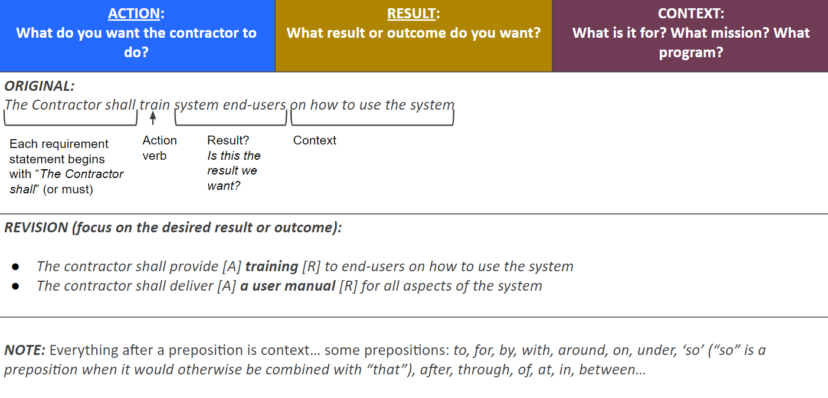
Use the ARC Method
Work as a collaborative team!

Slide 34
ACTION – RESULT – CONTEXT
ACTION: What do you want the contractor to do? | RESULT: What result or outcome do you want? | CONTEXT: What is it for? What mission? What program?
The Contractor shall develop [A] meeting materials [R] for public safety stakeholder engagements. [C] Historically meeting materials have included agendas, presentations, talking points, and facilitator guides. This ARC statement has a clear action, result and context. The context may be limiting for other business units to be able to use it, is that ok?
Consider creating separate tasks with the “approved” dependency… Original: The contractor shall create and execute a ___ plan for ___ Revision The contractor shall create a ____ plan for _____ The contractor shall execute an approved ____ plan so that ____
WARNING: “at the direction of ___” , “as requested by ____”

Slide 35
ACTION – RESULT – CONTEXT
ACTION: What do you want the contractor to do? - verb | RESULT: What result or outcome do you want? | CONTEXT: What is it for? What mission? What program?
ORIGINAL: The contractor shall be required to create or implement approaches to gather internal or external agency data through data collection, surveys, or questionnaires.
REVISION: The contractor shall create (A) data collection methodologies (R) for internal or external data used in support of Agency Projects and Programs. The contractor shall gather (A) data (R) from internal or external sources using approved data collection methodologies.
ORIGINAL: The contractor shall utilize the appropriate data collection or management approaches to prepare, process, and manage internal or external data utilized in analysis/modeling efforts. The contractor may utilize data collection equipment, such as Profile Analysis & Monitoring Systems (PAMS) and Portable Emissions Measurement Systems (PEMS), or database management systems (DBMS). The contractor may be responsible for data storage and reporting of all information utilized in the task area.
REVISION: The contractor shall prepare, process and manage (A) internal and/or external data (R) using approved data collection and management methods to support analysis and modeling efforts. (C)

Slide 36
Agile Scrum Development Example
  The Contractor shall conduct Agile Sprints, including all Scrum ceremonies to produce demonstrable “incremental deliveries” of working software.
As determined by the Agency PO, these deliveries of capabilities may or may not be fielded to the operational community.
Each iteration/sprint should be time boxed, that is the iteration/sprint should have a fixed duration (2 weeks).
  The Contractor shall virtually conduct Sprint Planning Sessions during which they will commit to completing a set of user stories from the product backlog up to their capacity (this may be done using story points and average velocity).
  The Contractor shall virtually conduct a Sprint Demo at the conclusion of each sprint that demonstrates the successful completion of user story acceptance criteria for each story and that the sprint has met the Sprint Definition of Done.
  The Contractor shall make daily Sprint Backlog updates in the approved Agile scrum project management tool, including user story percent complete and user story status.
  The Contractor shall virtually conduct Daily Scrum sessions with the Development Team, Scrum Master, and the Agency PO to identify and clear impediments and roadblocks.
  The Contractor shall virtually conduct and document Sprint Retrospectives at the conclusion of each sprint.
  The Contractor shall virtually conduct a Backlog Refinement Session to discuss the product backlog of user stories, establish acceptance criteria, and to ensure the Dev Team fully understands the objectives of all user stories eligible for inclusion in the next Sprint cycle.

Slide 37
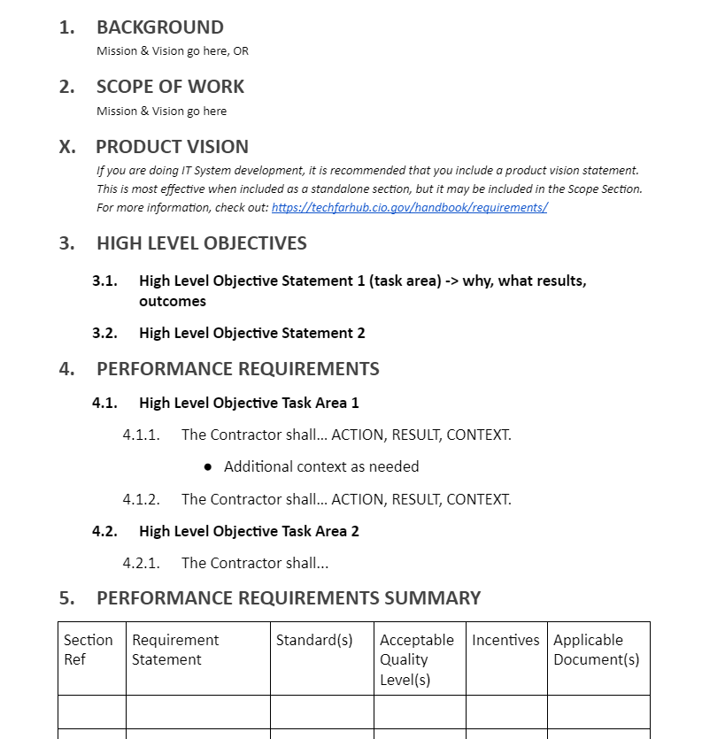
NO GIANT PARAGRAPHS
Use
  Short sentences & bullets
  Lists
  Tables
  Bold, Italics, Underline
Write for your specific audience
  Balance technical and plain language
  Write for the vendor you’ve never worked with before
Stop using government jargon!
Notes:
eBuy Open
RFQ1362167 Narcotic and Explosive Dog Services for Sierra Army Depot Herlong, CA Department of the Army
and RFQ1367416 AMIS, Zebra and Quagga Mussel Canine Detection

Slide 38
Ambiguity in Writing
Ambiguity is the use of vague, indefinite, uncertain terms and words with double meanings.
Examples of some ambiguous words and phrases include “provide assistance,” “support,” “manage all aspects of…,”
They are ambiguous because one can’t quantify, precisely measure, or state objectively what these phrases mean.
Avoid words that could suggest personal services as a result of detailed supervision of contractor employees. Government staff don’t supervise any contractor employees. We conduct contractor surveillance. Beware of supervision, actual or implied:
  Example: “as directed” [by a government employee]
Notes:
Presenter
2020-03-12 14:26:26
--------------------------------------------
Use of any and either. These words imply a choice in what needs to be done
contractually. Unless the intent is to give the contractor a choice, specify the true intent. For instance, the word any means a limited number selected at the discretion of the reader (contractor). The statement, “mow any areas over....” can mean any of the areas selected by the contractor, while “mow areas over..” means every area spelled out in the requirements. The word either implies a choice between two options. For instance, “clean glass on either side” is incorrect if the intent is to require the contractor to clean both sides of the glass.
2. Use of and, or, and/or, and etc. Use and if both conditions are true, and or if only one of the conditions is true. Avoid using and/or, because using those two words together creates ambiguity. That is, they may be intended to indicate that both conditions are true or that only one is true, and it is unknown which of the two cases is intended. Avoid the use of etc. because the reader may not be aware of what constitutes of the subset of etc.
3. Minimize as shown or as specified herein to generally refer to other parts of the PWS or other documents. Make explicit references to a page or paragraph.
4. Avoid:
as required as applicable
as necessary
These words leave too much discretion to the contractor. If you have to use these, explain the specific circumstances under which an action would be applicable, required, or necessary. Is it the contractor or the government who determines it something is applicable, required, or necessary.
5. Avoid qualifying phrases to modify the actions of the contractor. PWS requirements must be definitive and clearly stated. These are ambiguous:
as approved by to the satisfaction of in the opinion of
at the discretion of unless otherwise directed by insofar as possible to all intents and purposes pending future development

Slide 39
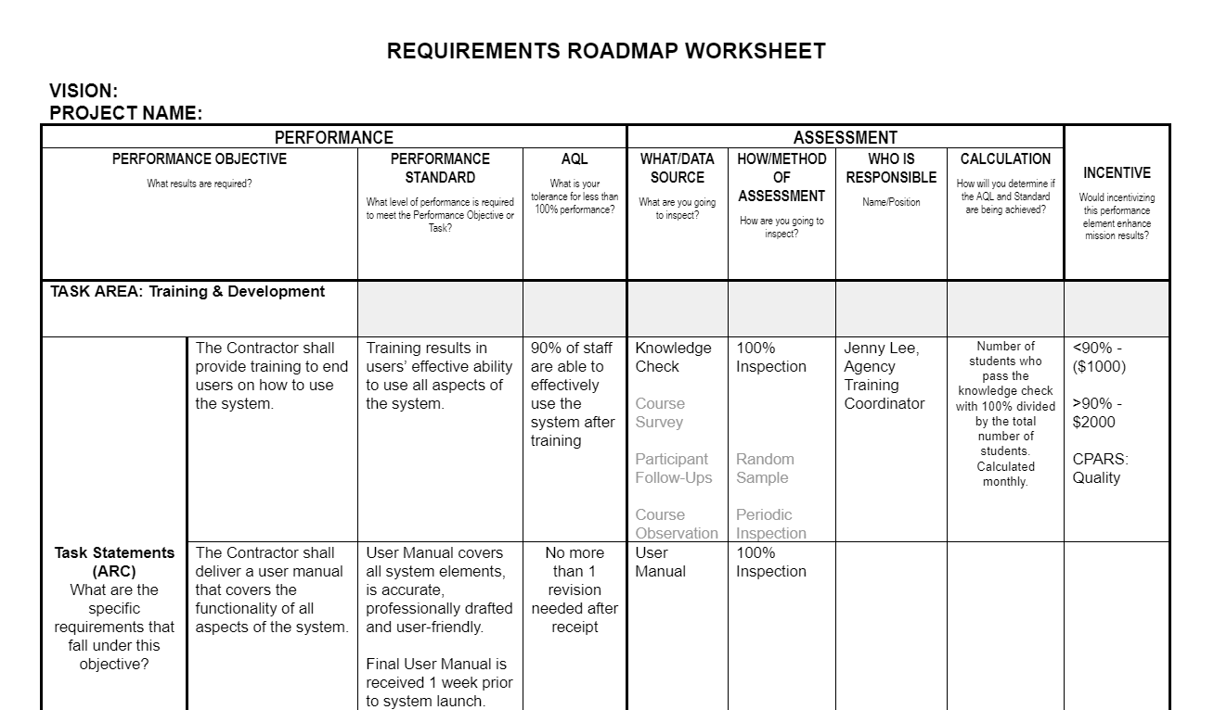
Requirements Roadmap Worksheet

Slide 40
Resources

Slide 41

What is a Civilian SAW?
A Civilian Services Acquisition Workshop (CSAW) is a facilitated workshop built around a specific acquisition and its multi-functional integrated project team (IPT). The workshop facilitates the team through the performance-based acquisition (PBA) process from beginning to end.
Notes:
Requirements are set forth in clear, specific, and objective terms with measurable outcomes
Does not state HOW the work is to be performed or have a broad and imprecise statement of work
Use of the word "acquisition" rather than "contracting" reflects the broader scope (from mission planning through contract closeout) and the broader community (including program offices) that are a necessary part of the process.

Slide 42

Workshop Purpose & Objectives
PURPOSE
Develop the mission, measurable objectives, requirements and performance-based strategies for the {Agency Requirement} and a roadmap to complete it.
OBJECTIVES
Understand and Apply the Performance-Based Acquisition (PBA) process and the Steps to PBA
Explore the tools, resources, techniques, innovations and best practices to successfully execute this requirement
Collaborate as a team through facilitated activities to develop draft documentation for this requirements
Develop a high-level roadmap for successful implementation of this performance-based acquisition
Gain consensus on critical decisions and the path ahead

Slide 43
CSAW Benefits
What happens in a CSAW? | Resulting in...
Workshop brings the right team of people together based on pre-workshop engagement with executive sponsor(s) and project manager | Reduced lead times and better team dynamics
The highly structured, facilitated workshop is built around the specific needs of the team while walking them through all the steps in the PBA process | Greater participation and accelerated team performance
Teams collaborate to develop the mission, vision, high-level objectives, and team success factors | Clarity of purpose that is shared among all members
Teams identify market research needs, high-level risks, key stakeholders, and a high-level communications strategy | Better overall project management
Teams will identify and refine performance requirements with associated performance standards, AQLs, and quality assurance approach | Better performance outcomes
Teams work together on each step in the PBA process and document the additional actions that will need to be taken after the workshop to complete each step | A high-level roadmap for working together to accomplish the project
Throughout the workshop, the team will gain consensus on their work products and path ahead | Increased stakeholder buy-in the end product

Slide 44
Information on CSAWs

Slide 45

Contact
Contact
Jonathan Evans
CSAW Program Manager & Senior Facilitator
Office of Professional Services & Human Capital Categories
GSA Federal Acquisition Service
Send Questions or Feedback to: csaw@gsa.gov

Slide 46
GSA Starmark Logo

Slide 47
Questions?

Slide 48
ThankYou!
Office of Integrated Marketing

