Slide 1
Information Technology Category
Multiple Award Schedule
ITC SOLUTIONS TRAINING

Slide 2

Agenda
Federal Acquisition Service
  Information Technology Category
  IT Modernization Efforts
  Acquisition Support Initiatives
Multiple Award Schedule
  Master Contract, Pricing, & Ordering
  Blanket Purchase Agreements
  Contractor Teaming Arrangements
  Ancillary and Order Level Materials
  GSA FastLane Program
  Pre-Competed Vehicles
Real Life Use Cases + Success Stories
GSA Support Tools

Slide 3

ITC Partners through MAS
Information Technology Category
(ITC)
Acquisition Solutions & Category Expertise
Assisted Acquisition Service
(AAS)
Custom Support Services
ITC partners with agencies to deliver information technology solutions through the Multiple Award Schedule (MAS).
Managing $34B+ in government IT spending.
Saving customers agencies $2B each year.
Cost avoidance through established pricing.
Improving procurement acquisitions lead time.
Incorporating supply chain risk management.
Customer and Stakeholder Engagement (CASE)
Strategic
Relationships
Technology Transformation Service
(TTS)
Digital
Transformation

Slide 4

ITC is a key player and partner for agency
IT modernization.
Cloud (XaaS): Order Guide
Zero Trust (ZT) Architecture: Buyers Guide
Post Quantum Computing (PQC)
Artificial Intelligence (AI)
Machine Learning (ML)
Blockchain
Internet of Things (IoT)
Emerging Technologies

Slide 5
Acquisition Support Initiatives
HELPING AGENCIES DELIVER SUCCESSFUL ACQUISITIONS
Program Management Benefits: Cost, Schedule, and Performance.
Smarter Cost
Savings
Established Not-To-Exceed ceiling prices.
Prices have been determined "Fair and Reasonable".
Competition at the order level will further drive price discounts.
Reduce administrative costs by using pre-competed acquisition vehicles.
Faster Procurement Time
Support through the entire acquisition lifecycle (pre/post award).
Complementary scope and requirement reviews.
Market Research Assistance (M-RAS) and acquisition vehicle recommendations.
Faster acquisition awards (PALT) by using pre-competed acquisition vehicles.
Federal Market Strategy
Achieve socio-economic targets / credits (direct and indirect) awards.
Leveraging the buying power of the government by Category Management.
Ability to access small business vendors of a variety of socio-economic categories for set-asides.
Delivering savings, value, and efficiency.
Compliance Focused
Compliant with ALL federal legislation, regulations (FAR), and policies.
Acquisition vehicles managed by GSA acquisition workforce professionals.
Compliant with Section 801 of the National Defense Authorization Act for FY 2008.
Additional agency regulations and policy requirements can be included at the order level.

Slide 6
Multiple Award Schedule (MAS)
Providing access to pre-vetted suppliers.
Incorporating supply chain risk mitigation.
Specialized Item Numbers for IT buying.

Slide 7
IT SINs
IT Services
Cloud & Software
IT Hardware
Telecom & Satellite
Specialized IT Categories
Identity, Credentials, & Access
SIN 54151S - IT Professional Services
SIN 54151HACS - Cyber Security
SIN 54151HEAL - Health IT
SIN 511210 - IT Software Licenses
SIN 54151 - IT Software Maintenance
SIN 518210C - Cloud Solutions
• 518210 - IaaS, PaaS, Saas
• 541519 - Cloud Labor
SIN 33411 - IT Hardware
SIN 532420L - IT Leasing
SIN 811212 - Hardware Maintenance
SIN 517312 - Wireless Mobility Solutions
SIN 517410 - Commercial Satellite Communications Solutions
SIN 541370GEO - Earth Observation Solutions
SIN 518210FM - IT - Core Financial Mngt. Solutions FM QSMO
SIN 54151ECOM - Electronic Commerce
SIN 561422 - Automated Contact Center Solutions
SIN 611420 - IT Training
SIN 541519ICAM - ICAM (non-PIV) Products & Services
SIN 541519PIV - Personal Identity Verfication (PIV) Products & Services
SIN 541519PKI - Public Key Infrastructure (PKI)
SIN 541519CSP - Identity Proofing & Authentication

Slide 8


BPA Use Story
Air Force awarded a $5.7B IT Service Management, Service Desk, and end-user devices Blanket Purchase Agreements (BPA) using the Multiple Award Schedule (MAS).
ITC provided market research, scope reviews, technical SMEs, and lessons learned from previous Blanket Purchase Agreements.

Slide 9
MAS: Master Contract
Master IDIQ Contract Awarded under FAR 12 – Acquisition of Commercial Items & FAR 38 – Federal Supply Schedules (FSS).
Long-term government-wide “Potential 20 year” contract with commercial companies that provide access to ever changing commercial IT offerings.
Base schedule contract options are formally reviewed every five (5) years to ensure vendors remain compliant and commercial pricing remains competitive.
  Contract ceiling does not apply.
Industrial Funding Fee (IFF) (paid by Industry, not the customer).
Continuously refreshed supplier base offering access to small businesses for set-asides.
Compliance with ALL applicable Federal Regulations and Policies.
Established End User License Agreements (EULA) for software.
Worldwide Coverage (CONUS/OCONUS).

Slide 10
MAS: Speed, Cost Savings, & Compliance
Acquire commercial information technology from pre-qualified vendors at lower than open-market prices in less time than going the traditional full and open route.
Contract pricing based off of negotiated best commercial pricing and allowing agencies to further negotiate rates and pricing.
Established contractor compliance checklist that all vendors must comply with.
What baseline Supply Chain Risk Management (SCRM) requirements are included?
  Kaspersky Lab
  Section 889 (Part A & B)
  Trade Agreements Act (TAA)
  Made in America” (MiA) Country of Origin Designations
Using data analytics/AI Bots to search for potentially non-compliant items.
GSA blocks and removes non-compliant products.

Slide 11
MAS: Schedule Ordering & Contract Pricing
MAS: Schedule Ordering
MAS: Contract Pricing
Using the eBuy system, agencies (buyers) may prepare and post Requests for Quotations (RFQs) for specific products and/or services.
Ordering via Subpart 8.4 - Federal Supply Schedules
Vendors propose established rates.
Agencies further negotiate discounts at the order level.
Ask about exceptions!
Additional agency terms, conditions, and flow down clauses are allowed, but cannot conflict with the master MAS contract.
Order-Level Materials (OLMs) and Ancillary Supplies and Services (ANCILLARY) are both types of supplies and services that can be used to support a GSA Schedule contract or BPA.
Multiple Award Schedule (MAS) contracts include:
  Pre-negotiated ceiling prices.
  Pre-negotiated terms and conditions.
FAR 8.405 - GSA Ordering Procedures
GSA prices for products and services are based on the best commercial pricing
  Contracting officers and negotiate to establish base pricing.
  Agency negotiations at the order level further decrease established ceiling prices.
  Other contract vehicles do not price, so agencies are at risk for overpaying for services or products.
  Ordering activities are required to seek a price reduction when the order exceeds the SAT (FAR 8.405-4).

Slide 12
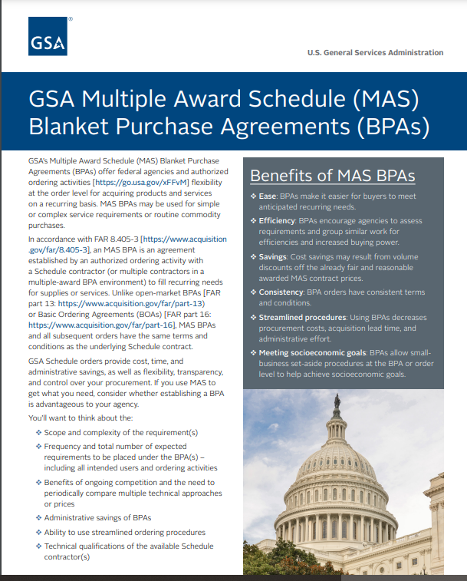
MAS: Blanket Purchase Agreement
The Multiple Award Schedule (MAS) Blanket Purchase Agreement (BPA) is a government contract that allows for the purchase of products and services through the MAS program.
An acquisition strategy to establish single or multi-award agreement in accordance with FAR 8.405-3..
Ordering activities can establish BPAs with schedule contractor(s) that can provide products, or IT services.
Agencies can establish a family of acquisition vehicles tailor-made to deliver IT solutions.
Allows agencies to consolidate, and conduct enterprise approach buying, realizing economies of scale.
Ability to award complex multi SIN and line item awards to buy services or products.
A BPA establishes terms applicable to future orders, and does not obligate funds and does not have ceilings or guarantees.

Slide 13
MAS: BPA Features & Benefits
MAS: BPA Features
MAS: BPA Benefits
Since BPAs are not contracts, you can build in simple cancellation language to deal with poor performers without the termination for convenience or default complexities
The “Contract Disputes Act” does not have jurisdiction over BPA agreements.
BPA’s do not have ceilings.
Ability for agencies to combine repetitive orders under a BPA reduces administrative costs.
Adopting an enterprise-wide BPA approach can streamline operations and improve the ordering process across the agency allowing for standardization.
  MAS provides standard terms, and conditions along with compliance, and awarding a BPA allows agencies to incorporate agency clauses.
Order Level Materials (OLM) up to 33% of total value of BPA.
Ability to establish agreements with multiple vendors maintains competition.
Streamlined BPA ordering procedures.
Increased flexibility in acquiring services and products.
Increases flexibility to plan for anticipated purchases.
Set-asides can be done for small businesses and any social economic class as determined through market research.
Does not require a minimum guarantee, or maximum ceiling.
Agency wide ordering through an established BPA increases flexibility to meet mission needs.
Ability to on-ramp additional vendors.
Addition of new technologies can be incorporated as they become available.

Slide 14
MAS: CTA Comparison
CTA vs. Prime/Sub Teaming Arrangement
Comparison | Contractor Team Arrangement (Multiple Companies) | Prime/ Subcontractor arrangement
Contract | Each team member must have a MAS contract. | Only the prime contractor must have a MAS contract.
Distribution of Work | Each team member is responsible for duties outlined in the CTA document. | The prime contractor cannot delegate responsibility for performance to subs
Privity of Contract | Each team member has privity of contract with the government and can interact directly us. | Only the prime contractor can interact with us. The prime contractor is responsible for subcontracting activities.
Invoicing | Each team member invoices the government buyer at unit prices or hourly rates as outlined in the task or delivery order, or blanket purchase agreement. | Prime contractors invoice the government buyer according to its MAS contract, which may include price reductions.
Scope of Work | Team members can offer total solutions quickly and easily. | Prime contractors can only provide the supplies or services that were awarded on its MAS contract.

Slide 15
MAS: Ancillary Supplies & Services
Ancillary Supplies and Services Special Item Number (SIN) is used for support supplies and services that are not covered by any other SIN on a schedule.
These supplies and services are intended to complement a contractor's offerings and provide a solution to a customer's needs. Here are some things to know about the Ancillary Supplies and Services SIN:
  Pricing: The price for these items is determined when the schedule or modification is negotiated.
  Incidentals: Ability to award incidental items at the schedule-contract level if they are routinely provided.
ANCILLARY | Supplies and/or services are support supplies and/or services which are not within the scope of any other SIN on this schedule.

Slide 16
MAS: Order Level Materials
Order-Level Materials (OLMs) Special Item Number (SIN) is used for supplies or services that are purchased to support a specific task or delivery order under MAS.
OLMs are used when the supplies or services are not known at the time the contract or BPA is awarded. Here are some things to know:
  Priced at the order level or BPA level, not in the contract or BPA.
  Sold as either Time & Materials (T&M) or Labor Hour under a Contract Line Item (CLIN).
  Only included in orders under authorized subcategories that have the OLM SIN.
  The value cannot exceed 33.33% of the total order or BPA value.
OLM | Order-Level Materials (OLM) are supplies and/or services acquired in direct support of an individual task or delivery order.

Slide 17
MAS: FastLane
The GSA FastLane is a program that helps government agencies access new technologies and innovative offerings by reducing the time it takes for GSA to process contract actions and add new companies onto the schedule. Here are some things to know about the process:
  Faster award cycles: Reduce the time it takes to process eOffers from 110 days to 30–45 days.
  Quicker contract modifications: Allows GSA to process contract modifications in as little as 24–48 hour adding new vendor products to their catalogs.
  More agile IT companies:Vendors can quickly update their contracts to meet customer needs.
The FASt Lane program is part of the GSA's Making It Easier (MIE) initiatives.
It was designed for eligible MAS vendors, to assist them getting onto contract or modifying contracts for new product additions.

Slide 18


Defense Innovation Unit Use Case Scenario
ITC is using its “FASt Lane” process and works closely with DIU to onboard emerging tech vendors onto the GSA Multiple Award Schedules.
Recent successes include aquatic drones for NOAA hurricane tracking and Artificial Intelligence Information Operations for the U.S. Army.

Slide 19
Pre-Competed Vehicles
2GIT BPA (IT Hardware, Software, & Ancillary)
GSS BPA (Desktops/Laptops)
Printer BPA
GSA Advantage
New vehicles

Slide 20



Pre-Competed Vehicles (Click resources below)
2GIT
1
4
GSA ADVANTAGE!
GSS BPA
2
5
ASCEND
Cloud acquired
(coming soon)
GOVERNMENT-WIDE PRINTER BPA
3
6
SCRIPTS
(coming soon)

Slide 21
Buying Resources:
Ordering guidelines for MAS.
GWAC vs MAS solution comparison.

Slide 22
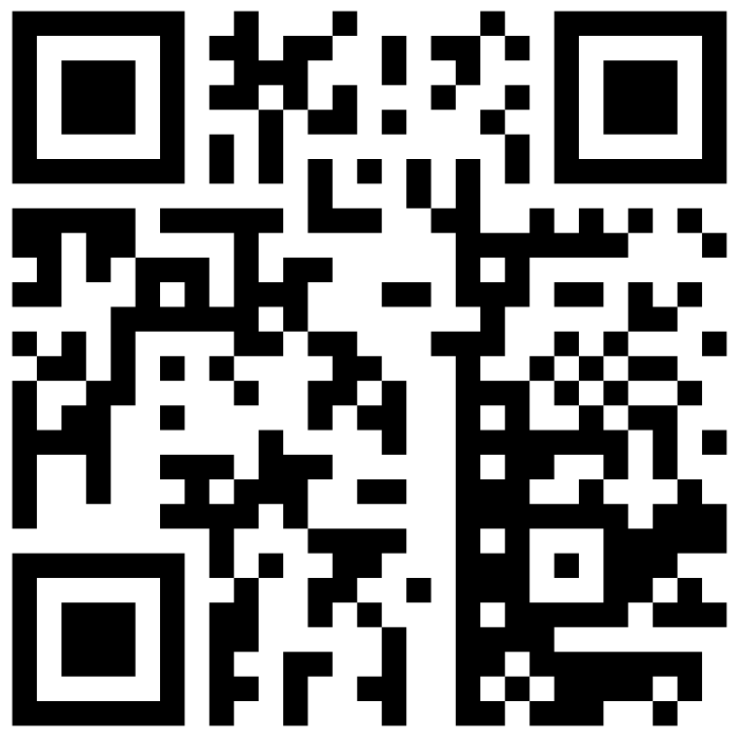
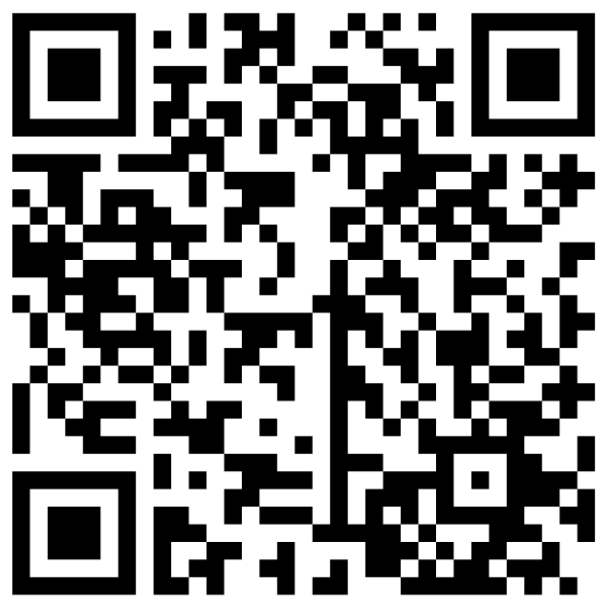
GSA Order Guides
Description: | QR Code:
Multiple Award Schedule Order Guidelines
Multiple Award Schedule Blanket Purchase Agreement

Slide 23
Ordering Procedures for Products & Services: without SOW FAR 8.405-1
EXCEEDS SAT
The ordering activity contracting officer shall provide an RFQ that includes a description of the supplies to be delivered or the services to be performed and the basis upon which the selection will be made
Develop the RFQ and post to GSA eBuy or provide the RFQ to as many Schedule contractors as practicable to reasonably ensure that quotes will be received from at least three
    (Document file if receive less than three quotes)
Limited Sources Justification, if applicable
Shall seek a price reduction (FAR 8.405-4) - Best value determination
May not place orders orally
MICRO-SAT
Ordering activities shall place orders with the Schedule contractor that can provide the supply or service that represents the best value
Survey ≥ 3 contractors (GSA Advantage, Catalogs, Pricelists)
Limited Sources Justification, if applicable
Determine if a price reduction should be sought
Best value determination
BELOW MICRO
Ordering activities may place orders with any Federal Supply Schedule contractor that can meet the agency’s needs
Although not required to solicit from a specific number of Schedule contractors, ordering activities should attempt to distribute orders among contractors

Slide 24
Ordering Procedures for Services: requiring a SOW FAR 8.405-2
MICRO-SAT
The ordering activity shall develop a statement of work, and shall provide the RFQ (including the statement of work and evaluation criteria) to at least three Schedule contractors that offer services that will meet the agency’s needs
Specify the type of order (i.e., firm-fixed-price, labor-hour) for the services identified in the statement of work
Limited Sources Justification, if applicable
Determine if a price reduction should be sought
Best value determination
BELOW MICRO
Ordering activities may place orders with any Federal Supply Schedule contractor that can meet the agency’s needs
Although not required to solicit from a specific number of Schedule contractors, ordering activities should attempt to distribute orders among contractors

Slide 25
Establishing a BPA for Supplies – FAR 8.405-3(b)(1)
EXCEEDS SAT
  Develop RFQ, including the basis of the award
  Post to GSA eBuy OR provide to as many Schedule contractors as is practicable to ensure at least three quotes
  Limited Sources Justification, if applicable
  Shall seek price reduction (FAR 8.405-4)
  Best value determination
BELOW SAT
  Survey ≥ 3 contractors
  Limited Sources Justification, if applicable
  Determine if a price reduction should be sought
  Best value determination

Slide 26
BPA Ordering Procedures: FAR 8.405-3
Procedures for Ordering from Multiple-Award Schedule BPAs (FAR 8.405-3(c))
EXCEEDS SAT
  Issue RFQ to all eligible BPA holders, or follow procedure for limiting sources
  Select best value quote
  Document best value determination and evidence of compliance with ordering procedures
MICRO-SAT
  Provide fair opportunity to all BPA holders or document reasons for restricting consideration
  Select best value quote
BELOW MICRO
  Place order with BPA contractor
  Distribute orders among BPA contractors

Slide 27
GWAC vs MAS Comparison
Alliant 2
MAS IT
FAR Authority
Ordering Governance
Protests
Statutory authority
Process to Use
Contractor Make-Up
Labor Categories & Rates
Period of Performance
Flexibility Parameters
Teaming
BPAs
Fair Opportunity
Far Authority
Ordering Governance
Protests
Statutory Authority
Process to Use
Contractor Make-Up
Labor Categories & Rates
Period of Performance
Flexibility Parameters
Teaming
BPAs
Fair Opportunity
Circles that overlap have a commonality, while circles that do not overlap do not share any of the other circles' traits.
For more information, (click here)
Scope
Contract Types, but Alliant 2 provides cost reimbursement in addition to the other
types

Slide 28




Value Proposition
Agencies benefit from choosing ITC because we offer a commitment to meet customer needs,
easy access to the best solutions, cost savings, and compliance with Federal regulations.
Customer Commitment
Acquisition and IT subject matter expertise
Responsive customer support to assist with emerging
tech needs
Training and decision-support tools available
Convenience
Variety & flexibility with uncompromising value & quality
Easy to identify and secure vendors, products and services
Achieve small business/socio-economic goals
Compliance
Align with complex federal regulations, laws, directives, and guidance
Reduce security and acquisition risks
Safeguard cyber assets and supply chains
Cost Savings
Reduce costs, save time and resources for the mission
Solutions with pre-negotiated & competitive pricing
Access to Best-In-Class offerings recommended by OMB

Slide 29



NOAA Use Case Scenario
NOAA Mission IT Services (NMITS) was a multi-award blanket purchase agreement approach awarded with a value of $2.1B to small businesses to compete on task orders. NMITS joins a family of IT acquisition vehicles tailor-made to deliver secure and compliant solutions.
ITC worked closely with NOAA during the entire acquisition life-cycle from pre to post-award. This helped the agency gain access to IT offerings from a variety of small business firms.

Slide 30
Support Tools

Slide 31
GSA Tools & Resources
SYSTEM (Click links below) | DESCRIPTION | MAS CONTRACTORS CAN: | GOVERNMENT BUYERS CAN:
eBuy | Electronic RFI/RFQ system | Tap into large customer base, access to RFI/RFQs | Request info, find sources, prepare RFI/RFQs
GSA eLibrary | Provides latest contract award information (GSA and VA schedules) | Research competition | Perform Market Research
GSA Advantage! ® | Online shopping and ordering system | Research competition, sell to the Federal Marketplace | Search for items, services, suppliers, perform market research, place orders, and compare features, prices, and delivery

Slide 32
Buyer Resources (Click Here)
Conduct Research | Develop Documents | Ready to Buy
Acquisition Solutions Navigator Pricing Intelligence Suite GSA Interact Buying guides Steps to Performance Based Acquisition Acquisition Gateway | Find Acquisition Documents Market Research as a Service (MRAS) Build a Cost Estimate (IGCE) Document Builder | GSA Advantage GSA ebUy GSA Global Supply Personal Property Managment System OASIS Symphony Commercial Platforms

Slide 33
Buyer Guide (Click Here)
01
Progress Tracker
Search, Select, Prepare, Submit
02
Buyer Homepage
Central Hub with quick access to your RFQs
03
3 Approaches - Keyword Search, Solution Guide, Acquisition Solution
Search for Solutions
04
Results are sorted by category number then subcategory number
Jump to Source & Source Listing
05
Select contractors to invite to quote on your RFQ
Post your RFQ
06
Post the RFQ
RFQ Information

Slide 34
Questions?

Slide 35
U.S. General Services Administration
Federal Acquisition Service
Office of Customer and Stakeholder Engagement (CASE)
https://buy.gsa.gov/help
Information Technology Category (ITC)
Customer Strategic Solutions Division (CSSD)
Inquiries can be sent to the ITC CSSD email box: ITCSSD@gsa.gov
CREDITS: Icons by Flaticon and infographics by Freepik
For more information, visit: gsa.gov

Slide 36
Appendix
ADDITIONAL RESOURCES
Multiple Award Schedule Details
Initiatives
MAS Ordering Procedures
Products and Services without SOW - FAR 8.405-1
Services Requiring an SOW - FAR 8.405-2
Establishing a Blanket Purchase Agreement (BPA)
Ordering Procedures
Supplies – FAR 8.405-3(b)(1)
Services – FAR 8.405-3(b)(2)

