Slide 1
GSA INFORMATION TECHNOLOGY CATEGORY
Acquisition Training for the Real World (ATRW)
Strengthening Agency Cybersecurity: GSA’s Highly Adaptive Cybersecurity Services (HACS) and Continuous Diagnostics and Mitigation (CDM) Solutions
IT Security Division (ITSD)

Slide 2




The Presenters
Terence Rountree, IT Security Division (ITSD) Director
Tammy Stathas, ITSD Information Security Specialist
Andrea Marshall, ITSD Information Security Specialist
Jeannette Grover, Cybersecurity Information Assurance and Privacy (CIAP) Branch Chief

Slide 3
Introduction
Part 1: IT Security Division Overview & Cybersecurity Drivers
  Terence Rountree, ITSD Director
Part 2: Cybersecurity Priorities and GSA Solutions
  Tammy Stathas and Andrea Marshall, ITSD Information Security Specialists
Part 3: Cybersecurity Supply Chain Risk Management (C-SCRM)
& GSA’s C-SCRM Acquisition Guide
  Jeannette Grover, CIAP Branch Chief

Slide 4
GSA INFORMATION TECHNOLOGY CATEGORY
IT Security Division Overview &
Cybersecurity Drivers
Terence Rountree
ITSD Director

Slide 5
Part 1: Agenda
About the IT Security Division (ITSD)
Interactive Poll
Recent Cyber Incidents
Emerging Technology
Federal Requirements & Guidance

Slide 6



ITSD is a key player and partner for agency IT modernization.
Manage
Provide
Assist
Manage the Highly Adaptive Cybersecurity Services (HACS) Special Item Number (SIN) on the Multiple Award Schedule (MAS)
Provide buyer’s guides and other resources to help our IT customers understand emerging technologies
Offer assistance and guidance to agencies navigating the complexities of their cybersecurity acquisitions

Slide 7
ITSD partners and collaborates with…
Information Technology Category
(ITC)
Acquisition Solutions & Category Expertise
Customer and Stakeholder Engagement (CASE)
Strategic
Relationships
National Institute of Standards & Technology (NIST),
Cybersecurity Security and Infrastructure Agency (CISA), & the Office of Management and Budget (OMB)
Custom Support Services
Advanced Technology Academic Research Center (ATARC) & American Council for Technology and Industry Advisory Council (ACT-IAC)
Government and Industry Developments

Slide 8

Interactive Poll
Which cybersecurity initiative is most important to your agency?
Zero Trust Architecture (ZTA) Implementation
Securing Emerging Technology
Cybersecurity Supply Chain Risk Management (C-SCRM)
Training the Cybersecurity Workforce

Slide 9





Notable Recent Cyber Incidents

Slide 10



Emerging Technology
Artificial
Intelligence (AI)
Post-Quantum
Cryptography (PQC)
The Internet
of Things (IOT)

Slide 11
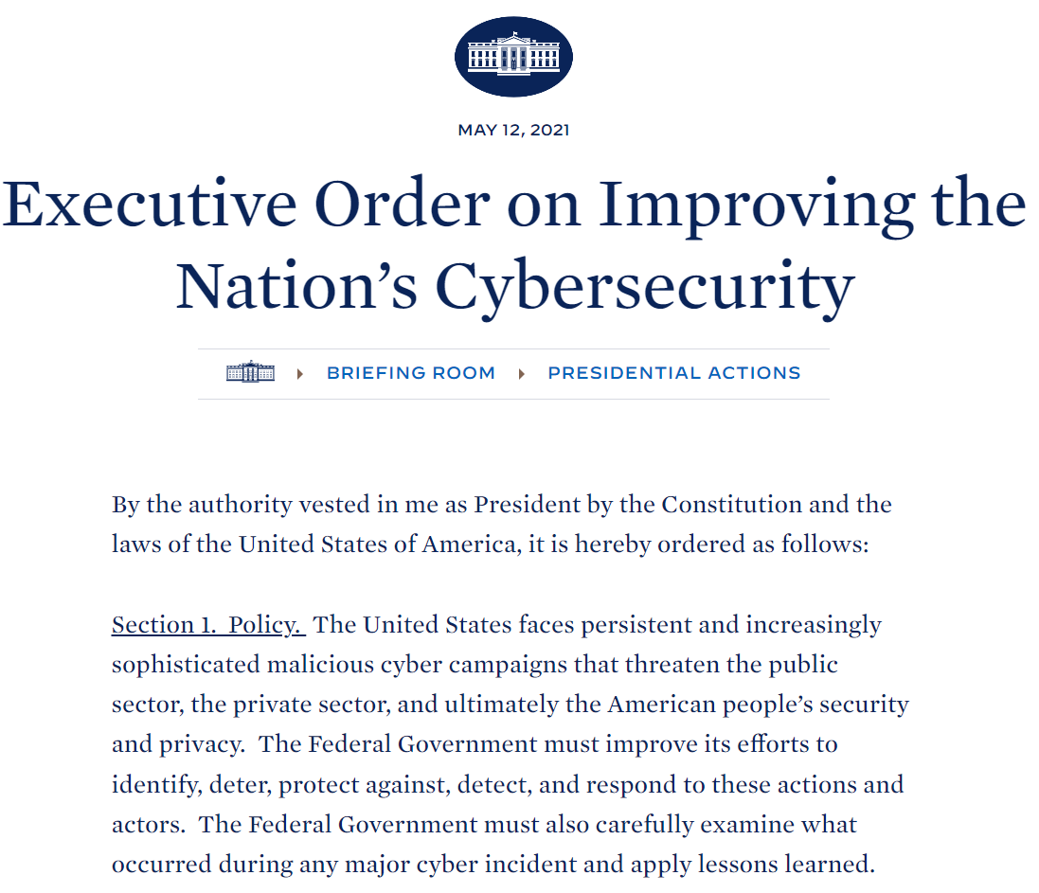
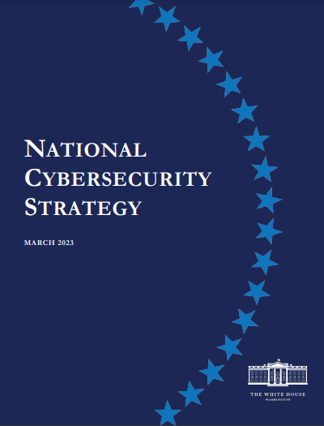
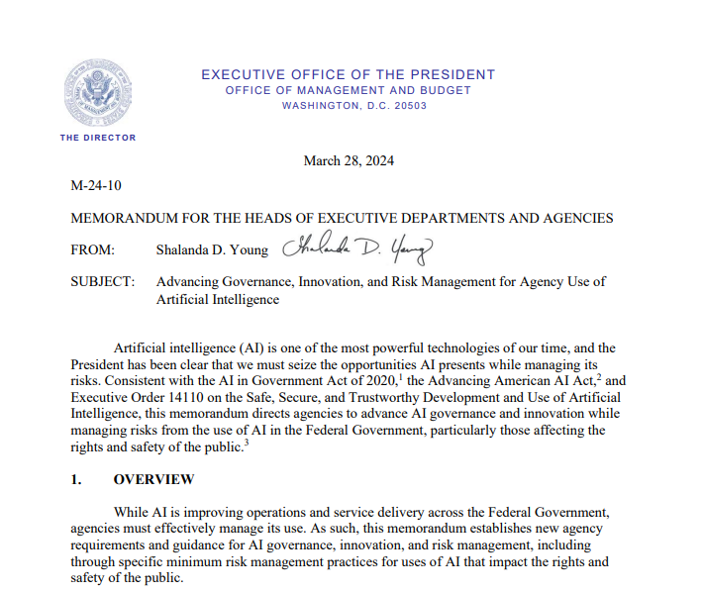
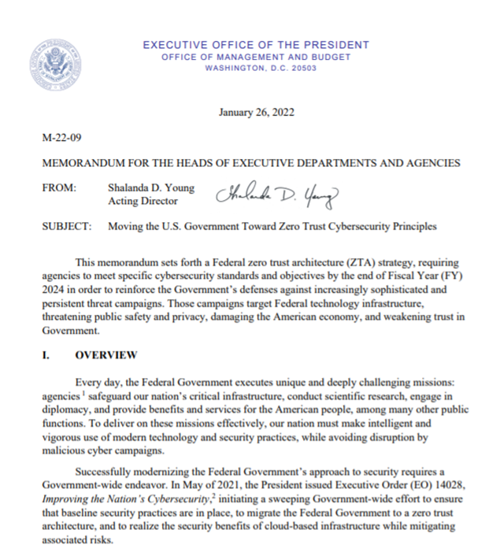
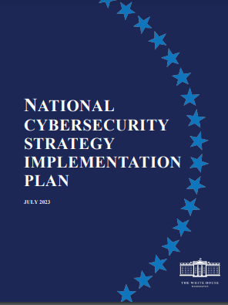
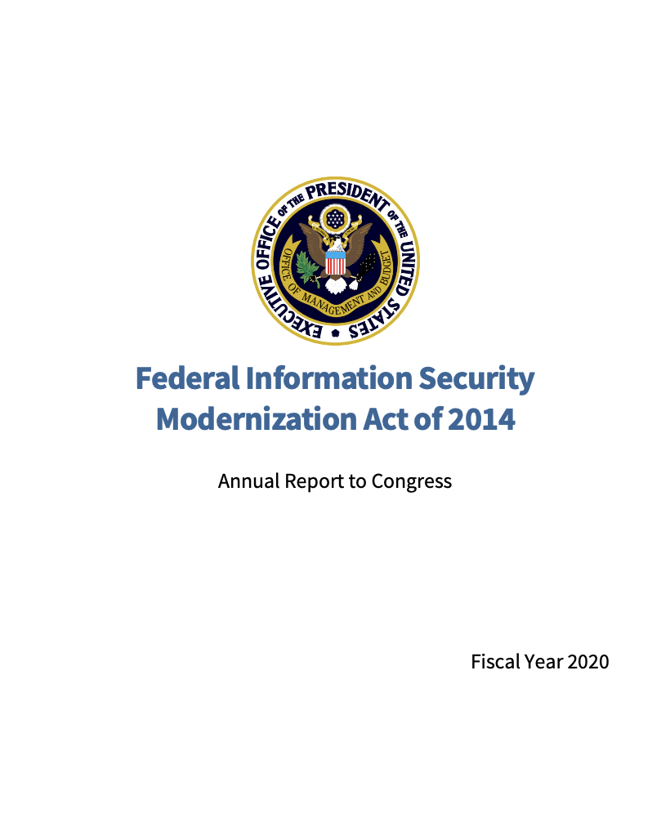
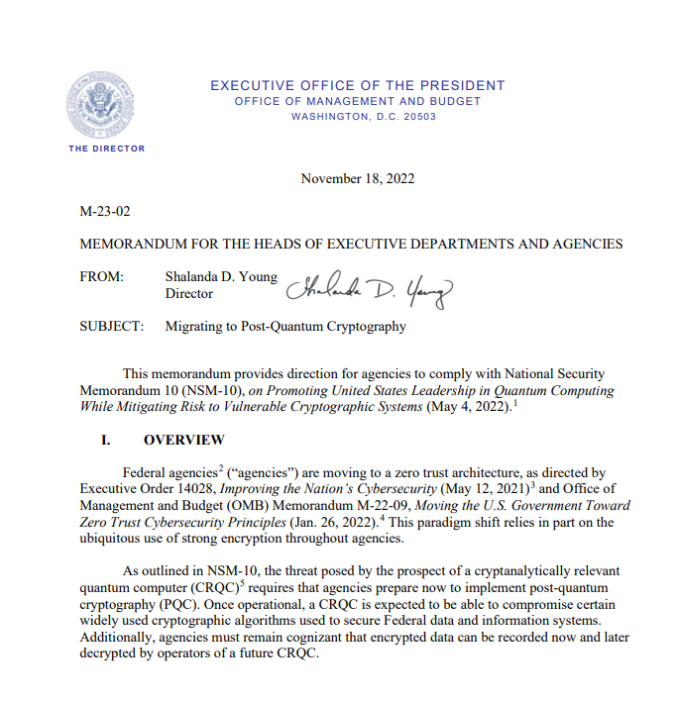
Federal Requirements & Guidance

Slide 12
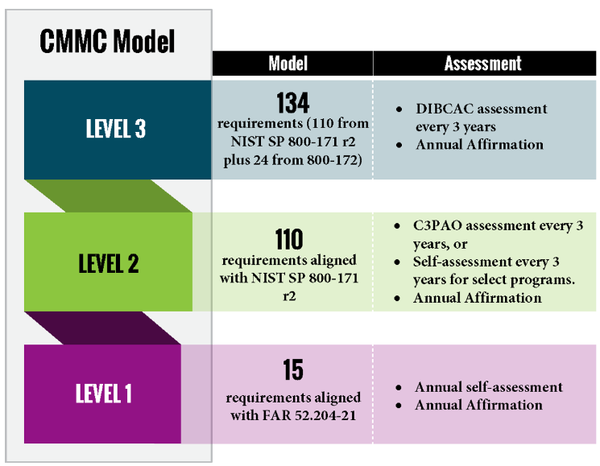
Cybersecurity Maturity Model Certification (CMMC)
Reference: https://dodcio.defense.gov/cmmc/About

Slide 13
GSA INFORMATION TECHNOLOGY CATEGORY
Cybersecurity Priorities and GSA Solutions
Tammy Stathas and Andrea Marshall
ITSD Information Security Specialists

Slide 14
Part 2: Agenda
Zero Trust Architecture (ZTA)
Cybersecurity Supply Chain Risk Management (C-SCRM)
Application Security Testing (AST)
Advanced Persistent Threats (APTs)
Multiple Award Schedule (MAS)
Interactive Poll
Highly Adaptive Cybersecurity Services (HACS) Special Item Number (SIN)
Continuous Diagnostics and Mitigation (CDM) Tools
Other GSA Resources
Q&A

Slide 15
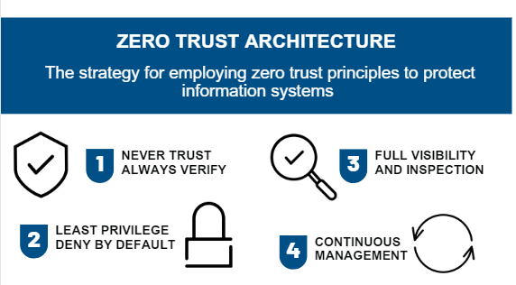
What is ZTA?
Zero Trust Architecture
The strategy for employing zero trust principles to protect information systems
1
Never Trust, Always Verify
3
Full Visibility and Inspection
2
Least Privilege, Deny By Default
4
Continuous Management

Slide 16
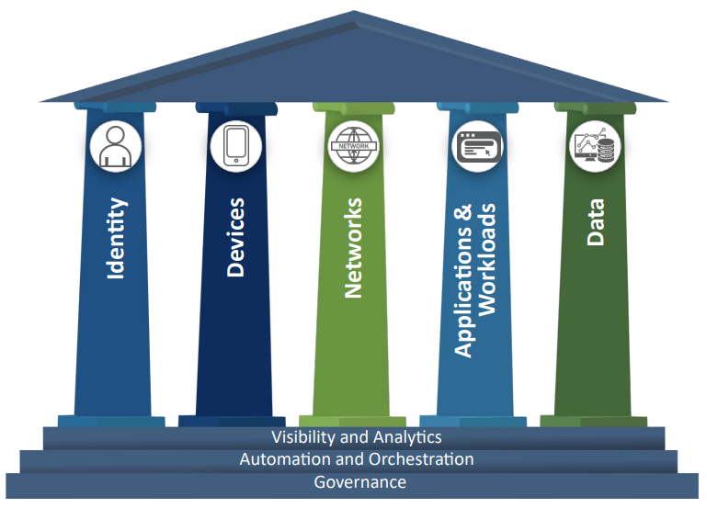
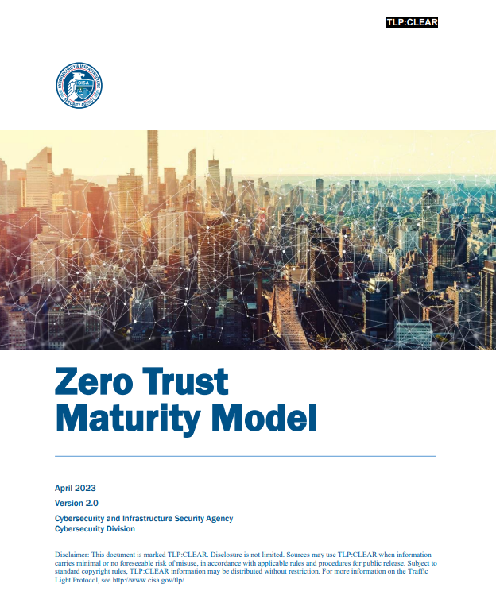
Zero Trust Maturity Model
Reference: www.cisa.gov/sites/default/files/2023-04/zero_trust_maturity_model_v2_508.pdf

Slide 17
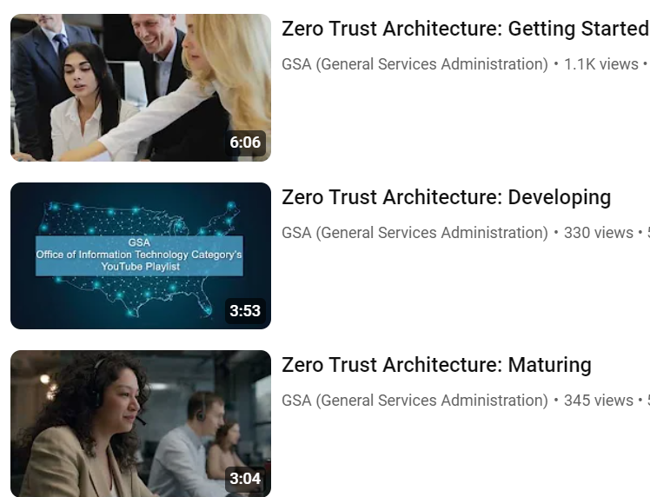
ZTA Use Case Videos
Search “GSA Office of Information Technology Category Playlist”
on YouTube

Slide 18
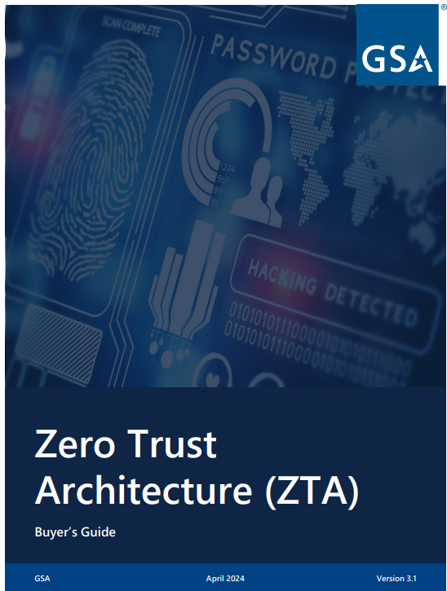
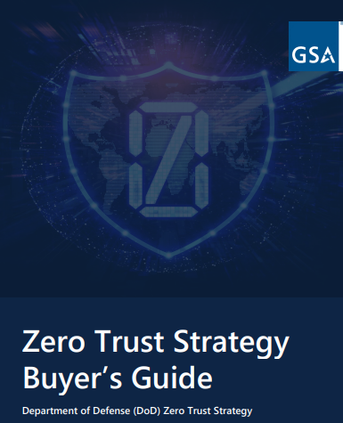
ZTA Buyer’s Guides
Available at https://www.gsa.gov/ZTA

Slide 19


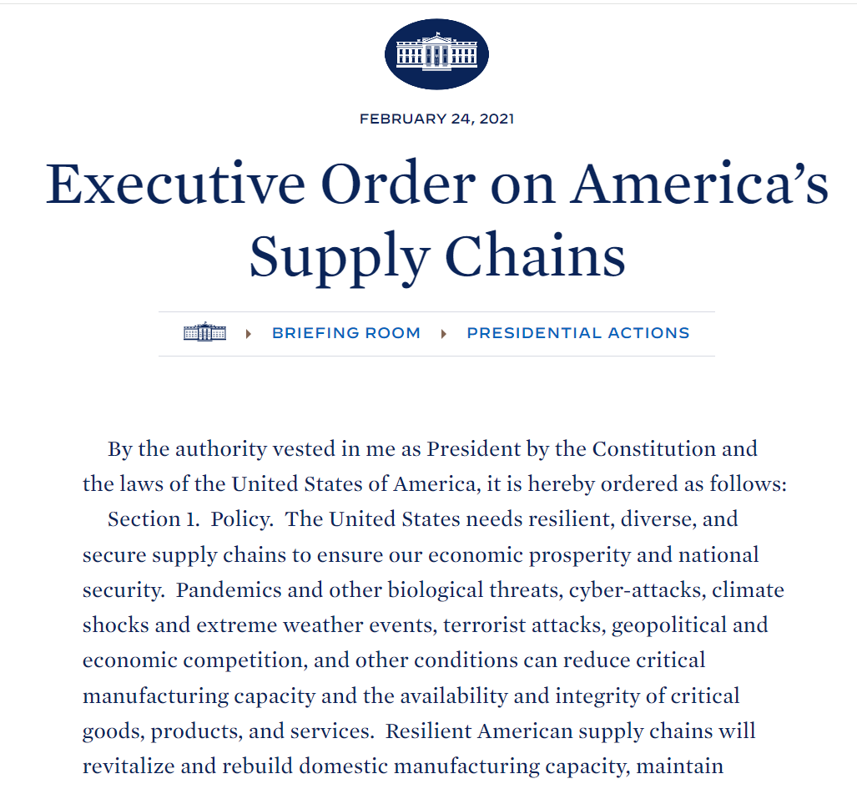
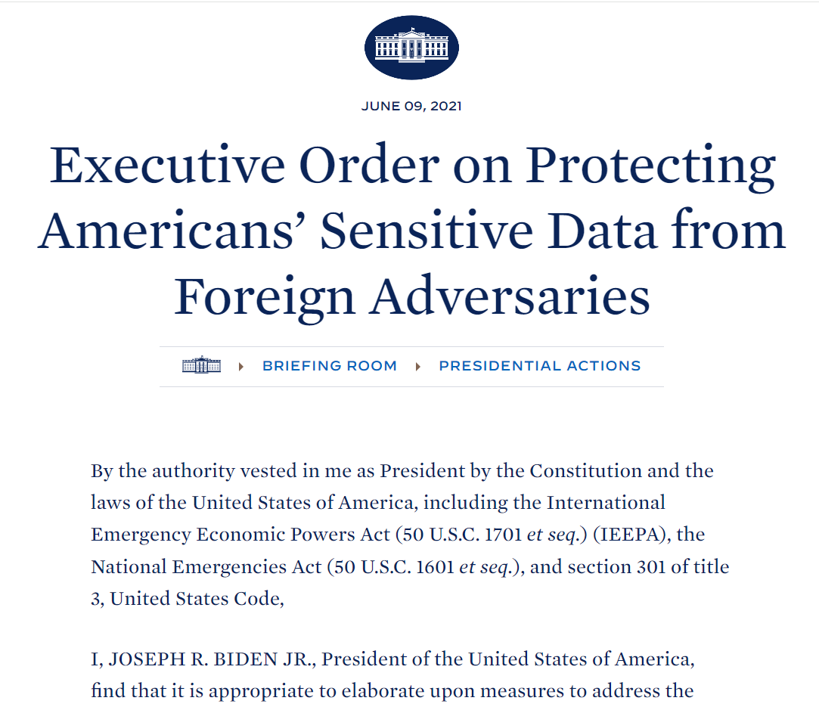
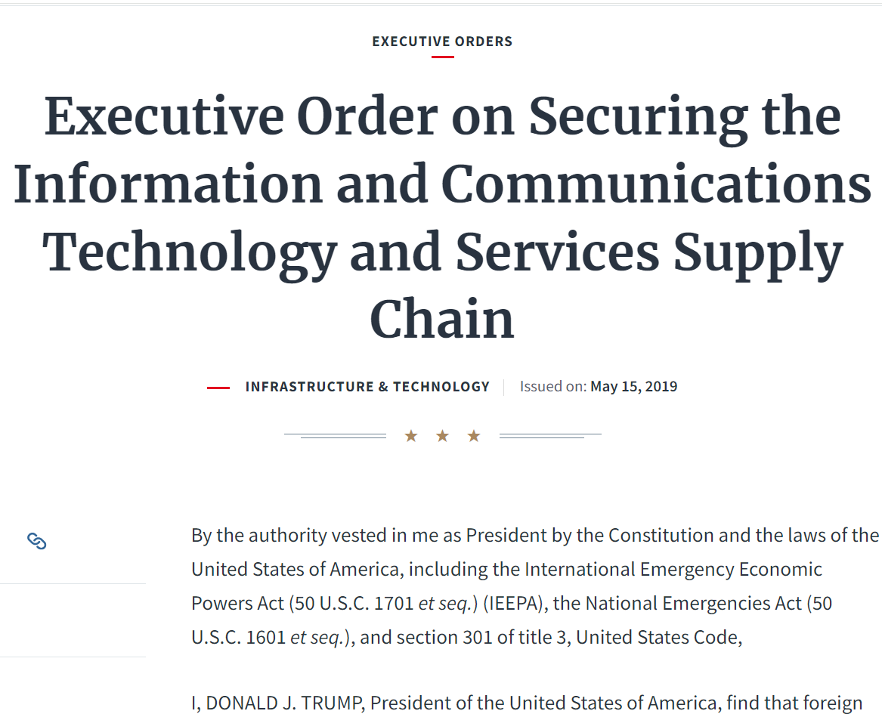
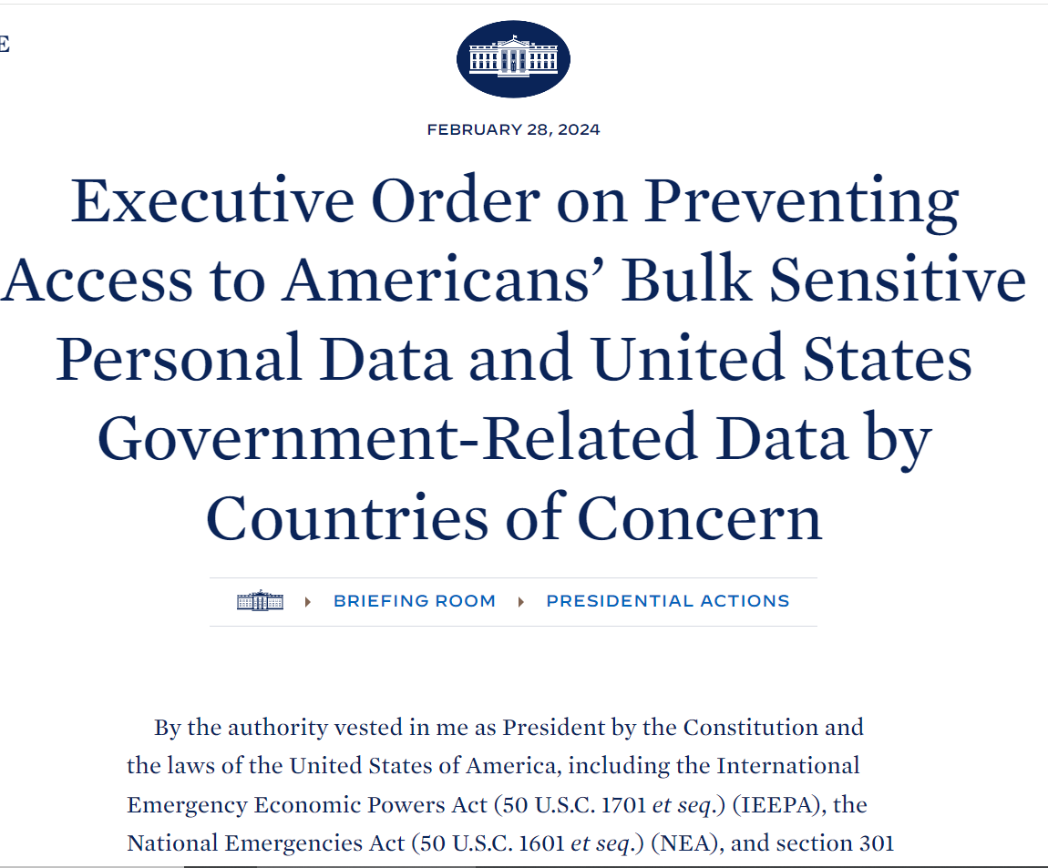



Why Cybersecurity Supply Chain Risk Management (C-SCRM)?
Supply Chain Risks
Federal Requirements & Guidance

Slide 20
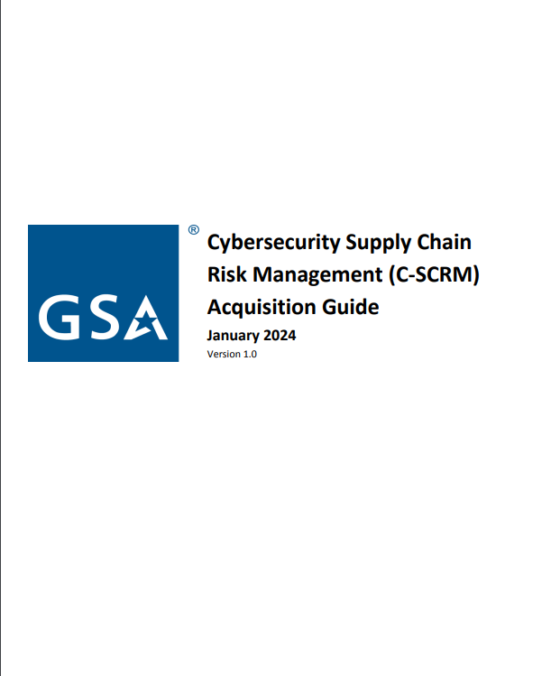
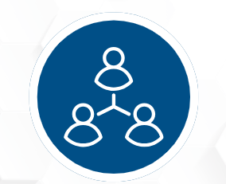
C-SCRM: How GSA Helps
ITC C-SCRM RESPONSE PROGRAM
Available at: https://www.gsa.gov/ITSecurity

Slide 21
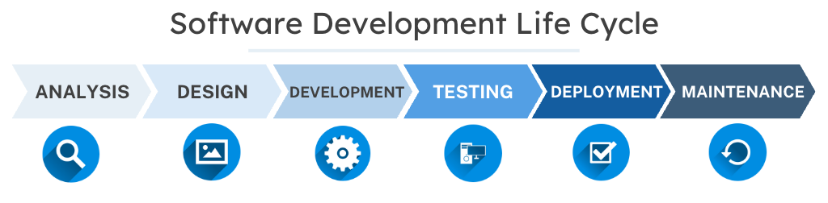
Why Application Security Testing (AST)?
Testing software for security vulnerabilities is an important part of the Software Development Life Cycle.
Adversaries can exploit vulnerabilities to gain privileged access to networks, applications, and data.

Slide 22
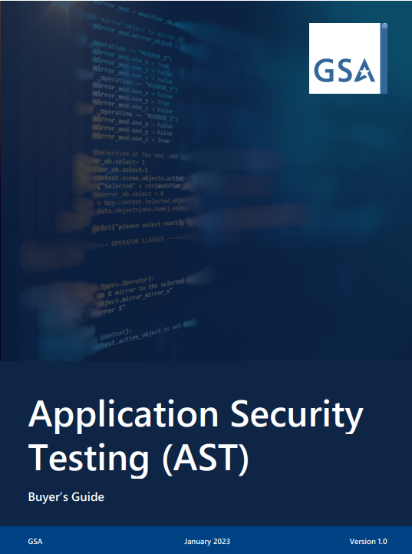
AST Buyer’s Guide
Available at https://www.gsa.gov/AST

Slide 23
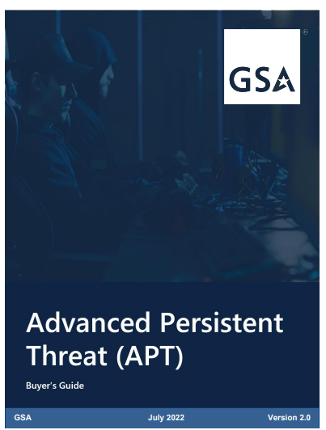
APT Buyer’s Guide
Available at https://www.gsa.gov/itsecurity

Slide 24

Multiple Award Schedule (MAS)
MAS offers:
7.5M products and services
Reduces buying cycles up to 50% vs. open market
New suppliers added continuously
SINs categorized as specific products and services
Supports firm-fixed-price, labor hour, and time and materials
Ability to establish Blanket Purchase Agreements

Slide 25
Interactive Poll
How knowledgeable would you say you are about the Highly Adaptive Cybersecurity Services (HACS Special Item Number (SIN)?
Very knowledgeable. My agency has used the HACS SIN to procure cybersecurity services.
Somewhat knowledgeable. I’m aware of the HACS SIN offerings, but my agency has not used it to procure cybersecurity services.
Not very knowledgeable. I’ve heard of it, but could learn more.
Not familiar at all. This is completely new to me.

Slide 26
Benefits of HACS
HACS SIN offers:
Access to a pool of technically-evaluated cybersecurity vendors
Ability to filter pool of vendors based on socioeconomic status
Rapid ordering and deployment of services
Reduction in open market ordering and contract duplication
Cybersecurity and acquisition support resources from GSA experts

Slide 27
HACS Services / Subgroups
The HACS SIN is organized into five (5) subgroups under which vendors are evaluated.
High Value Asset Assessments*
Assess Government’s critical, mission essential information systems
Risk and Vulnerability Assessments*
Identify and address vulnerabilities
Provide
mitigation countermeasures
Penetration Testing*
Mimics real-world attacks to identify security circumvention methods
Incident Response
Determines extent of cybersecurity compromise
Removes adversary
Restores network
Cyber Hunt
Proactively searches for malicious activities
*Indicates mandatory subgroup. Prospective HACS vendors must pass technical evaluation, inclusive of questions related to these subgroups, to be awarded the SIN.

Slide 28
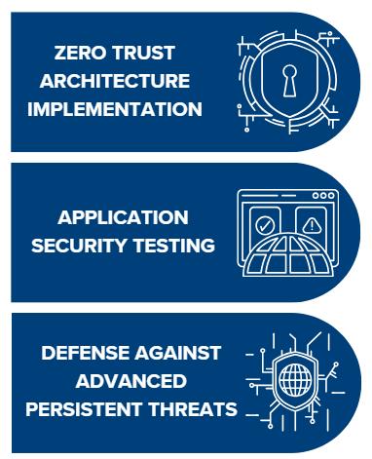
HACS Current Cybersecurity Priorities
Agencies can also leverage the HACS SIN to procure a wide-range of solutions to support Administration cybersecurity priorities.

Slide 29


Buying HACS
GSA eLibrary
Find HACS vendors, their terms and conditions, price list, business size, and socioeconomic designations
GSA eBuy
Learn more about how individual vendors’ capabilities can support your cybersecurity requirements. Visit eBuy to issue a Request for Information (RFI)
GSA eBuy Open
View previous HACS RFIs and RFQs for sample language and requirements
Free Scope Review
Request a free scope review from GSA to determine if your requirement can be supported through HACS

Slide 30
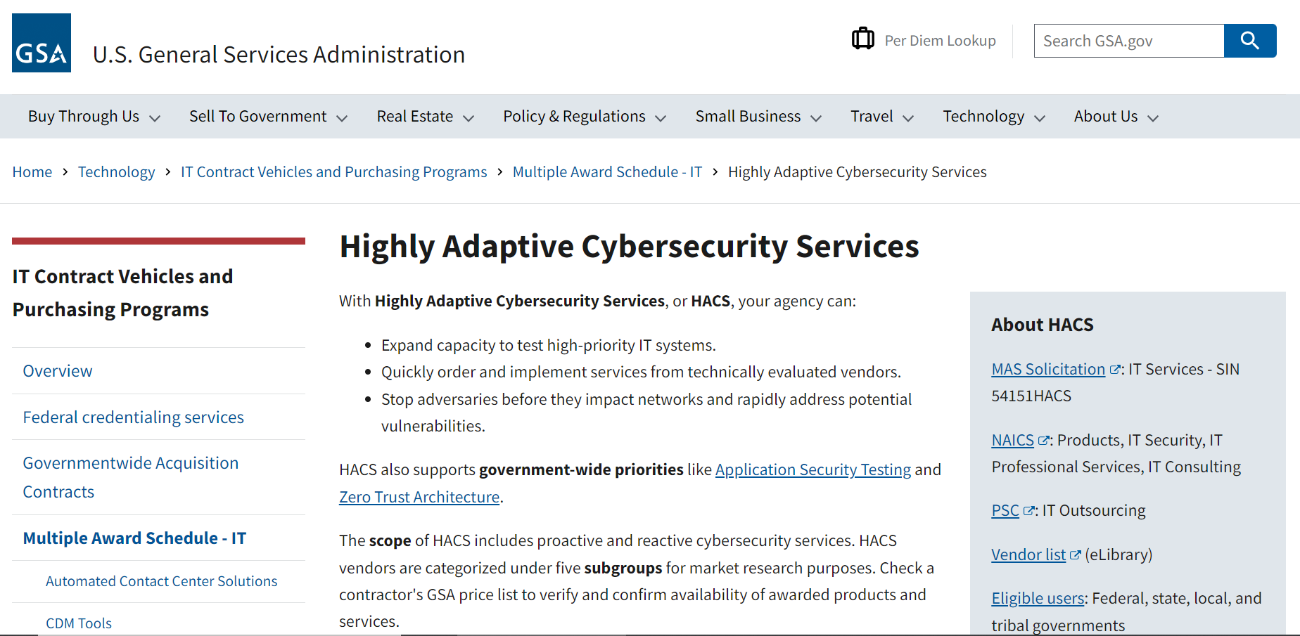
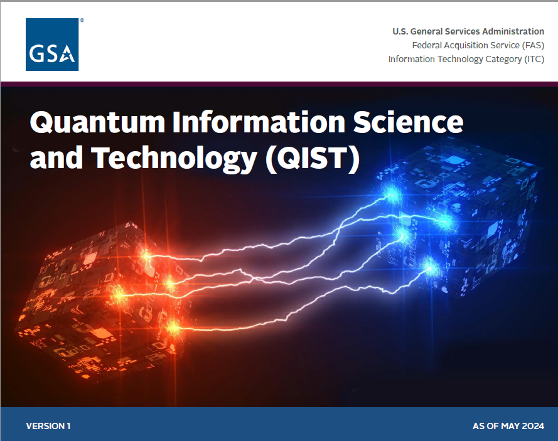
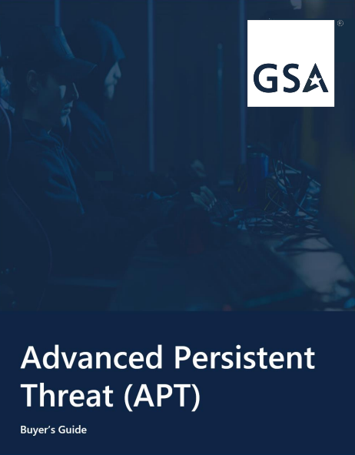
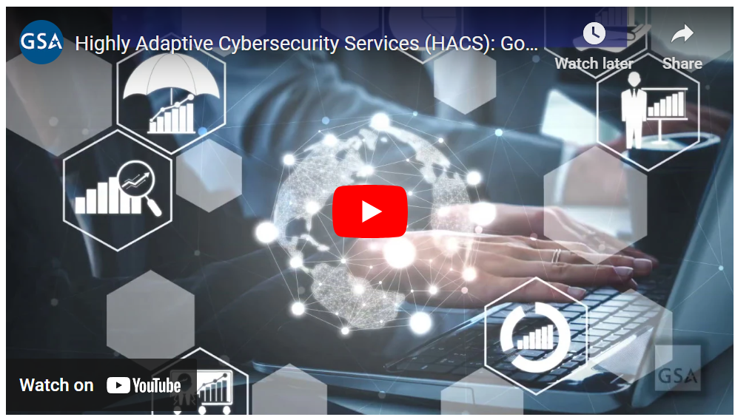
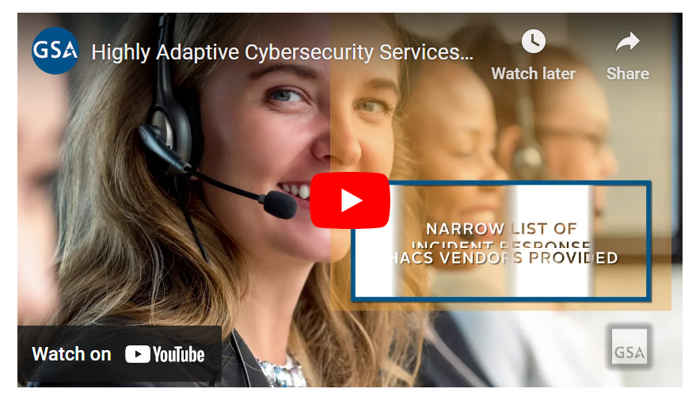
HACS Tools & Resources
Buyer’s Guides & Technology Book
Dedicated Websites
www.gsa.gov/HACS
www.gsa.gov/ZTA
www.gsa.gov/AST
www.gsa.gov/ITSecurity
HACS Toolkit
HACS Ordering Guide
Request for Quote (RFQ) Template
Statement of Work (SOW)
Templates
Informational &
Use Case Videos
HACS Independent Government Cost
Estimate (IGCE) Tool

Slide 31
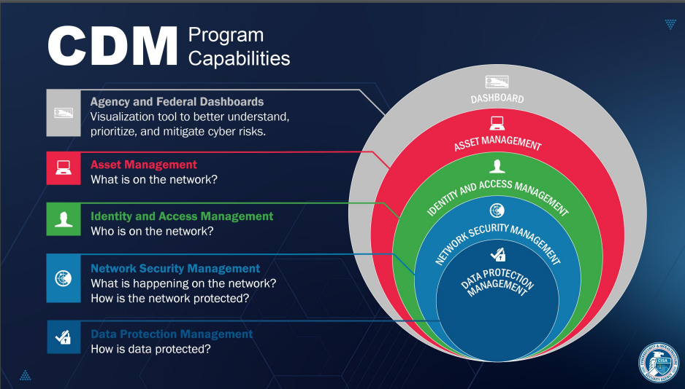
Continuous Diagnostics & Mitigation (CDM) Tools
For more information visit www.cisa.gov/cdm

Slide 32


How to Buy CDM Tools
On GSA Advantage!, a special CDM Tools Symbol distinguishes items on the APL managed by DHS Cybersecurity and Infrastructure Security Agency (CISA).
To learn more about CDM, please visit gsa.gov/CDM.

Slide 33




Additional GSA Contract Solutions
GSA offers several additional contract solutions designed to meet agencies’ acquisition needs and priorities.
Learn more by visiting GSA’s “IT Contract Vehicles and Purchasing Programs” website:
gsa.gov/technology/it-contract-vehicles-and-purchasing-programs

Slide 34
U.S. General Services Administration
Federal Acquisition Service
To learn more about GSA cybersecurity offerings, visit www.gsa.gov/itsecurity or email ITSecurityCM@gsa.gov.
Our Customer Service Solutions Division (CSSD) stands ready to support agencies with IT requirements. For technical assistance, or more information, reach out to itcssd@gsa.gov.
Find your agency’s GSA (National Account Manager) Point of Contact at www.gsa.gov/csd.

Slide 35
GSA INFORMATION TECHNOLOGY CATEGORY
Cybersecurity Supply Chain Management (C-SCRM)
Jeannette Grover
ITSD Cybersecurity Information Assurance and Privacy (CIAP) Branch Chief

Slide 36
Interactive Poll
How familiar are you with Cybersecurity Supply Chain Management (C-SCRM)?
Very familiar
Somewhat familiar
Not familiar at all

Slide 37
Interactive Poll
Which of the following are ways cybersecurity threats can be introduced into the supply chain? Select all that apply.
Insider threats
Malware inserted while being serviced
Poor quality manufacturing
Theft or alteration of system data
Counterfeit products or components

Slide 38
Training Objectives
Understand the importance of Cybersecurity Supply Chain Risk Management (C-SCRM).
Outline the steps for a supply chain risk assessment (SCRA) and supplier risk assessment.
Identify C-SCRM tool capabilities and map these capabilities to baseline risk factors.
Utilize sample requirements for the acquisition of C-SCRM tools and services.
This training is a companion to GSA’s Cybersecurity Supply Chain Risk Management (C-SCRM) Acquisition Guide (January 2024).

Slide 39

What is Cybersecurity Supply Chain Risk Management?
According to the National Institute of Standards and Technology (NIST), C-SCRM is...
… a systematic process for managing exposure to cybersecurity risks through the supply chain and developing appropriate response strategies, policies, processes, and procedures.

Slide 40
C-SCRM Risks Factors & Considerations
Counterfeit products or components
Delivery of products with malware
Security vulnerabilities in systems and networks used by supply chain partners
Theft or alteration of system data

Slide 41




C-SCRM Drivers | Supply Chain Risks
Physical Supply Chain Risks
COVID-19 Pandemic
Major Shipping Lane Disruptions
Global Conflicts
Weather Events & Natural Disasters
Cyber Attacks on Major IT Providers
Supply Chain Risks

Slide 42
C-SCRM Drivers | Federal Requirements & Guidance

Slide 43
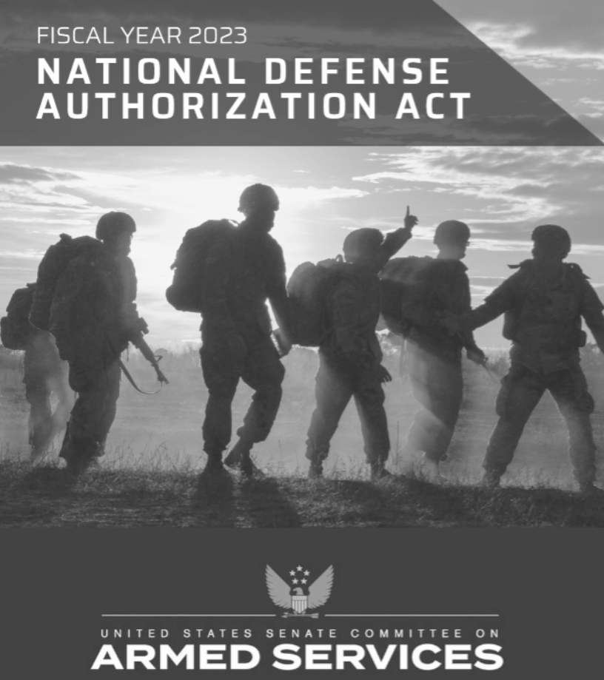
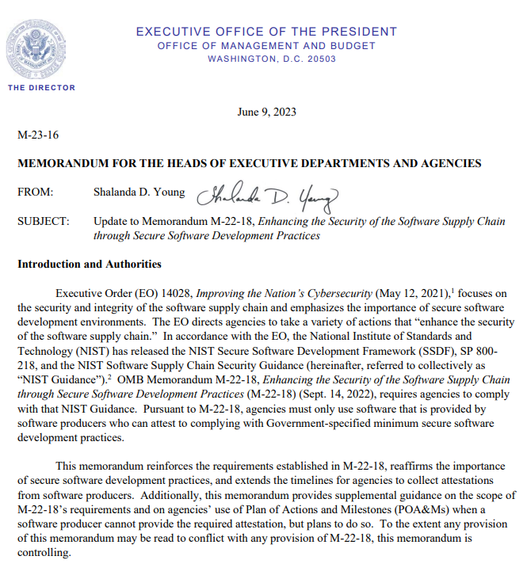
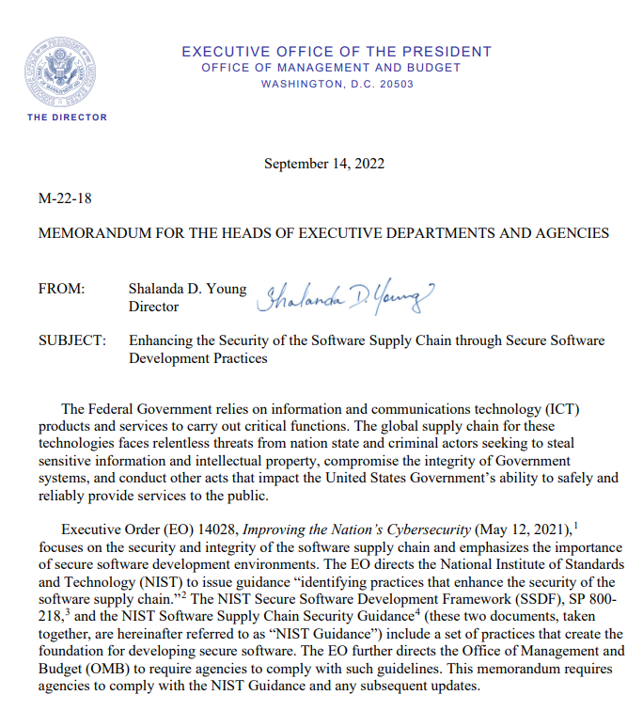
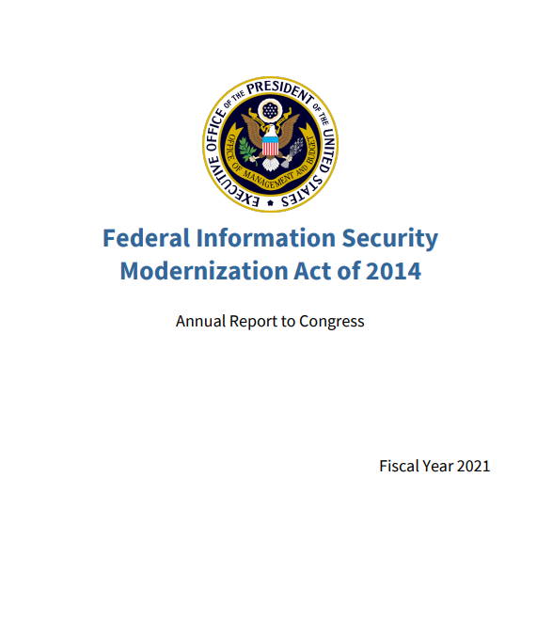
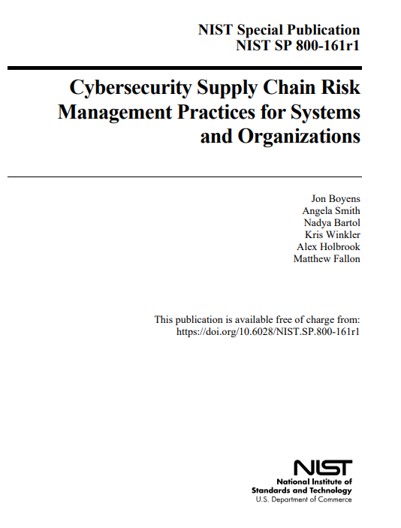
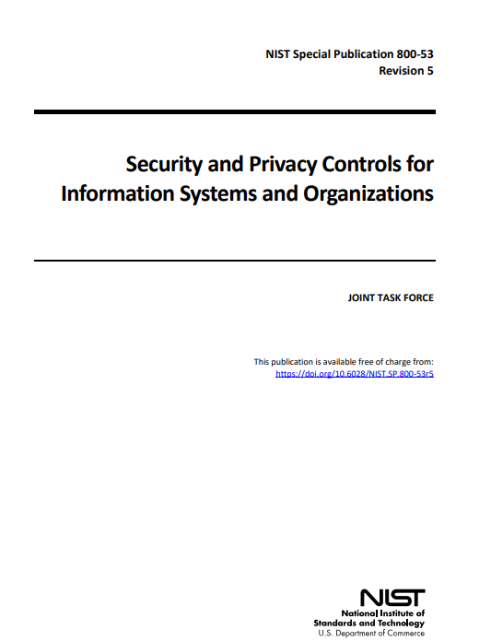
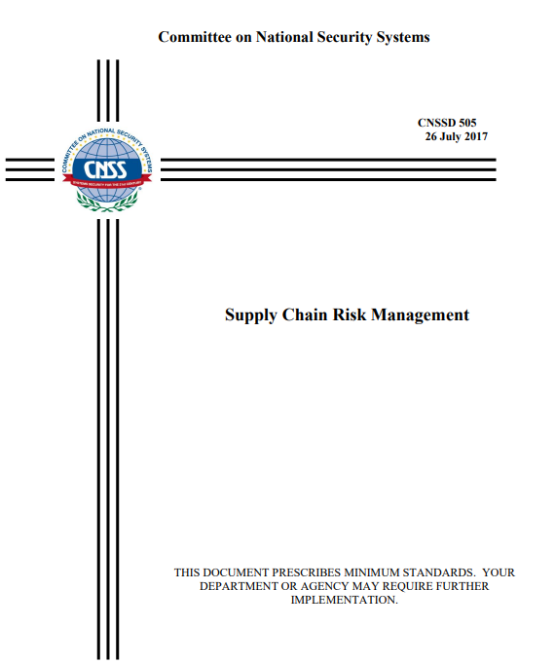
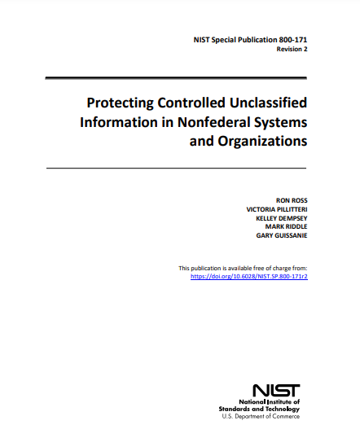
C-SCRM Drivers | Federal Requirements & Guidance

Slide 44
C-SCRM Drivers | IG FISMA Metrics
The Inspector General (IG) Federal Information Security Modernization Act (FISMA) reporting metrics assess agencies’ C-SCRM performance and maturity based on four measurements. Two of these four measurements explicitly focus on an agency’s C-SCRM capabilities.
These measurements evaluate whether the following is true:
Products, system components, systems, and services of external providers are consistent with the agency’s cybersecurity and supply chain requirements.
Counterfeit components are detected and prevented from entering the agency’s systems.

Slide 45



ICT/OT supply chains are exposed to threats.
Concerns about threats and vulnerabilities associated with acquiring Information and Communications Technology (ICT)/Operational Technology (OT) products and services include the following:
Malicious functionality
Counterfeit systems or components
Vulnerabilities due to poor manufacturing and development practices

Slide 46

Supply chains are extensive and globally distributed.
ICT/OT supply chains consist of the following:
Geographically diverse routes
Constantly changing technology and business environments
Multiple levels of outsourcing and offshoring

Slide 47
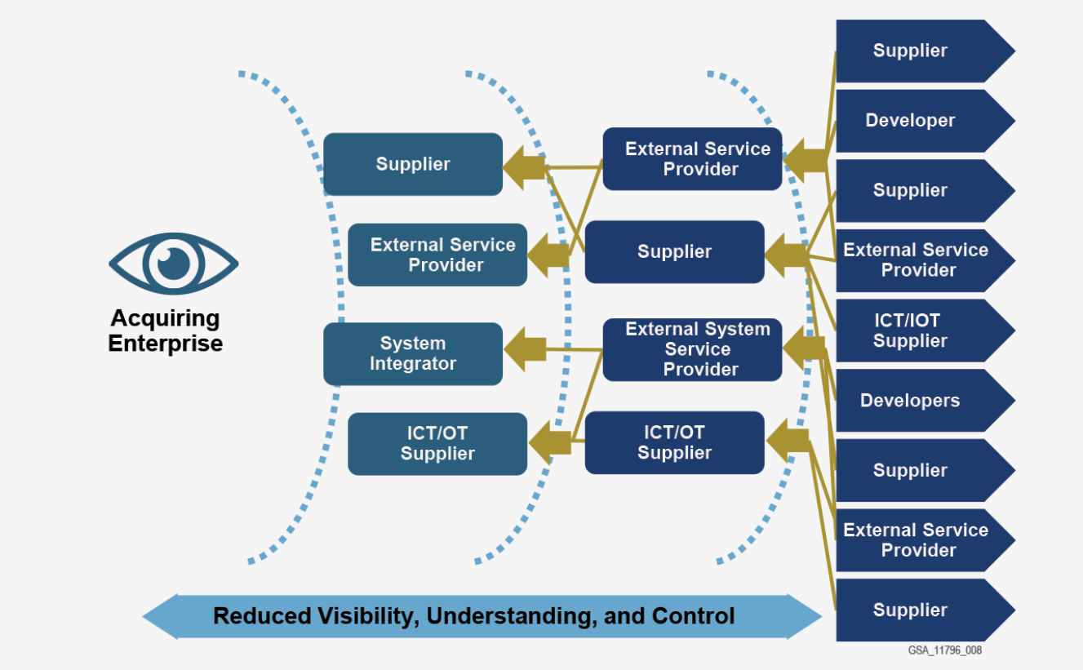
Challenges Posed by Extensive Supply Chains
An organization’s visibility into the supply chain decreases as the tiers of suppliers increase.
As visibility decreases, so does understanding and control of how ICT/OT products and services are handled at all stages of the system’s life cycle.
Figure adapted from NIST SP 800-161r1

Slide 48
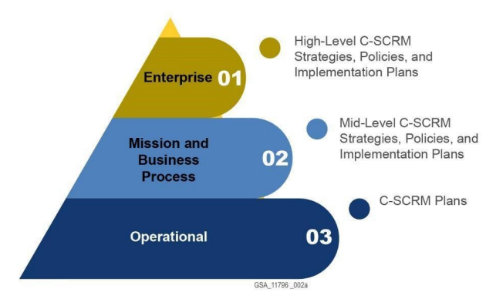
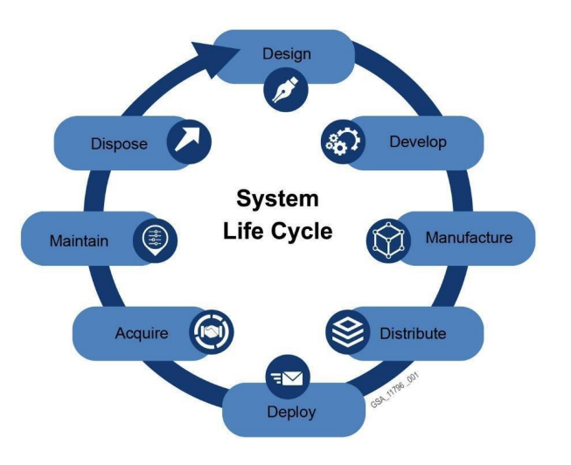
A Holistic Approach to C-SCRM

Slide 49
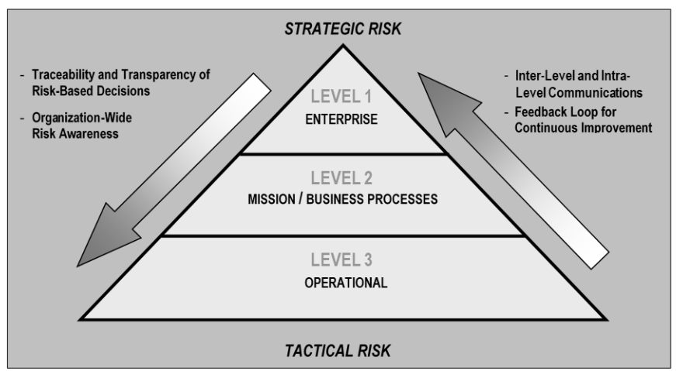
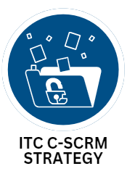
C-SCRM at ITC | Strategy and Oversight
ITC incorporates C-SCRM practices in every phase of the acquisition lifecycle.
NIST SP 800-161r1: Multilevel Enterprise-Wide Risk Management

Slide 50
Supply Chain Risk Assessments (SCRAs)
Cybersecurity SCRAs are an important process in C-SCRM and are required by Federal Acquisition Supply Chain Security Act and other regulatory and executive actions.
Conducting SCRAs
When to perform one
Why they are important
Identify and evaluate the supply chain-related risks that arise from using ICT/OT products and services
Prior to the acquisition or use of hardware, software, cloud services, and other technology- related services and periodically/regularly post-acquisition
Addresses potential vulnerabilities that could be exploited by cyber attackers to compromise the confidentiality, integrity, and/or availability of agencies’ data, systems, and networks

Slide 51
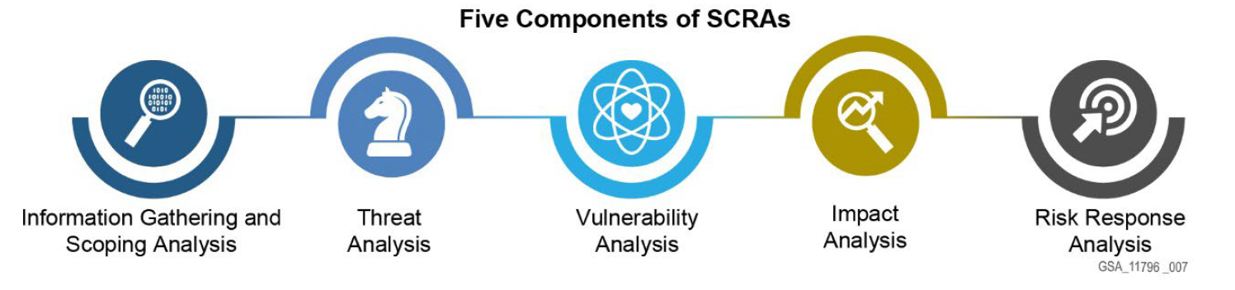
Five Components of SCRAs According to NIST
According to NIST SP 800-161r1, “SCRAs are intended to fairly and consistently evaluate risks posed to an agency via third parties that hold the potential for harm or compromise as a result of cybersecurity risks.”
NIST’s guidance describes five components of SCRAs to help organizations review cybersecurity risk in the supply chain, including exposures, threats, and vulnerabilities associated with ICT/OT supply chains, suppliers, and products and services.

Slide 52

Triggers for Conducting a Supplier Risk Assessment
New supplier, product, or service
Changes to market conditions
Technology changes or advances
Changes in regulatory requirements or compliance standards
Mergers, acquisitions, or divestitures
Disruption, incident, or cybersecurity breach involving the supplier or a similar supplier or competitor

Slide 53
SCRAs and Supplier Risk Assessments
Supplier Risk
Assessment
To get a full understanding of an agency’s risk environment when conducting an SCRA, there needs to be an understanding of the suppliers within an agency’s supply chain.
To do this, a supplier risk assessment can be performed.
SCRA
Broad
Enterprise-wide
Focuses more on strategies and policies
Specific
Provides insight into suppliers
Can help inform SCRAs
There is some overlap between SCRAs and supplier risk assessments. A supplier risk assessment can be used to inform an SCRA, but it can also be conducted independent of an SCRA.

Slide 54
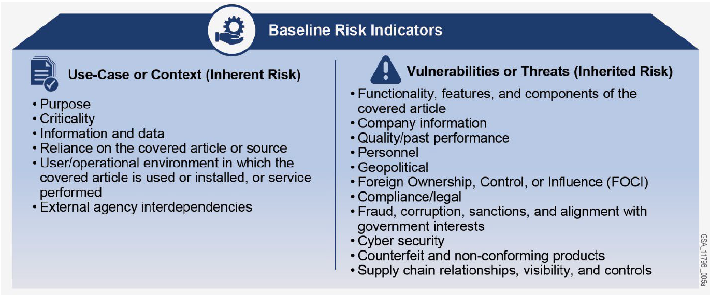
Baseline Risk Indicators for Data Comparison
Here are examples of core baseline risk indicators against which agencies can compare the data collected during an SCRA.
Notes:
For 508 compliance purposes, feel free to reference the graphic as a sample graphic on risk indicators that is available in the acquisition guide, but avoid referencing this material on the graphic directly. It is not readable through Reader programs.

Slide 55




Role of C-SCRM in the Acquisition Life Cycle
Each supplier's enterprise, products, and services, as well as their suppliers and supply chains may introduce cybersecurity risks in the supply chain. This is why performing supplier risk assessments is important.
In order to help manage those supply chain risks, the customer should incorporate considerations into the procurement process. C-SCRM related acquisition activities that occur during a supplier risk assessment include:
Performing market analyses
Conducting due diligence
Evaluating and selecting bidders
Monitoring

Slide 56

C-SCRM at ITC | Vendor Assessments
GSA uses Vendor Risk Assessments (VRAs) throughout the acquisition lifecycle to identify potential risks in the the supply chain.
Pre-Award
VRA
Post-Award
VRA
Foreign ownership, control, or influence | Financial stability
Cybersecurity hygiene | Prohibited products

Slide 57


C-SCRM Tools and Advisory Services
Businesses can provide some valuable products and services that address agency C-SCRM requirements.
Supply chain
illumination tools
Supplier risk assessment capabilities
Products and services risk assessment capabilities

Slide 58

Supply Chain Illumination Tools - Connections
Illumination tools identify potential or confirmed supply chain connections. Connections may be:
Supplier-customer relationships directly related to the product or service being provided
Related to other products or services provided by the supplier
An indirect relationship like providing office furniture or supplies

Slide 59
Supply Chain Illumination Tools - Mapping
Ideally supply chain illumination tools should help map a supplier’s supply chain throughout each stage of the system development life cycle (SDLC).
Design and development
End of life disposal
Manufacturing
Sustaining and maintenance
Delivery and deployment
Systems integration

Slide 60






Supplier Risk Assessment Capabilities
Some C-SCRM tools offer services to identify and assess supplier risks related to:
Quality of products and processes & resilience practices
Internal security & integrity practices
Financial stability
Location of supplier’s facilities & operations
Logistical routes used to move components & products
Ownership, foreign control and influence, mergers & acquisitions

Slide 61
Products and Services Risk Assessment Capabilities
Product testing/verification tools can:
Determine whether the product or service being procured is developed with appropriate security controls to ensure confidentiality, integrity, and availability of information systems and data throughout the SDLC.
Assist with asset detection, inventory, and vulnerability management activities such as analyzing component inventories like Software Bills of Materials (SBOMs).

Slide 62

Currently, no C-SCRM tool can provide everything.
The number of companies that offer supply chain risk management tools is increasing. Many companies offer this capability through their Software as a Service (SaaS) platforms using Machine Learning (ML) and Artificial Intelligence (AI) solutions to address C-SCRM needs.
Currently, no C-SCRM tool can do it all.
  Each tool only addresses a subset of baseline risk indicators listed in Table E-1 for NIST SP 800-161r1.
  No tool can provide holistic C-SCRM capabilities .

Slide 63
MAS Categories Specific to Information Technology
There are multiple MAS categories related to IT.
There is not a dedicated MAS category specific to C-SCRM.
Instead, C-SCRM products, services, and solutions can be found in multiple IT categories, posing a challenge of accessibility.
Access the IT MAS categories using the links below.
Electronic Commerce
(SIN 54151ECOM)
IT Hardware
(SINs 532420L, 33411, & 811212)
IT Training
(SIN 611420)
IT Services
(SINs 54151HACS, 54151HEAL, & 54151S)
Telecommunications
(SINs 517312 & 517410)
IT Solutions
(SINs 518210C, 518210FM, 541370GEO, 541519PIV, 541519ICAM, & 541519PKI, 561422)
IT Software
(SINs 511210 & 54151)

Slide 64
Government Buyers Seeking Commercial Capabilities
Due to the growing availability and effectiveness of commercial C-SCRM tools and advisory services, government buyers should seek these capabilities when appropriate to help identify, assess, and respond to baseline risk factors listed in NIST SP 800-161r1.
Government buyers should develop C-SCRM requirements based on both their agency and mission:
Risk appetite
Risk tolerance

Slide 65


Considerations for Contract-Related Documentation
When writing contract-related documents (RFQ, SOW, etc.) for C-SCRM tools and services, agencies should develop requirements for each type of acquisition:
Every agency has a different risk appetite and risk tolerance.
Because of this, each agency will need to decide on the pertinent requirements to include in contract-related documents.
Different projects within an agency may also have different risk appetites and risk tolerances.
C-SCRM tool capabilities (including both supply chain illumination and supplier risk assessment tools)
System requirements for C-SCRM tools
Professional contractor services

Slide 66



Procuring C-SCRM Advisory Services
Foundational
In addition to acquiring C-SCRM tools, agencies can also seek out advisory services to support in various C-SCRM functions.
For example, C-SCRM subject matter experts can assist agencies with foundational, sustaining, and enhancing C-SCRM practices identified in NIST SP 800-161r1.
Sustaining
Enhancing

Slide 67
GSA C-SCRM Acquisition Guide
Available at: https://www.gsa.gov/ITSecurity

Slide 68


More C-SCRM Tools & Resources
Dedicated Websites
IT Security
IT Vendor Management Office
GSA Events & Training
Informational Videos
GSA’s ITC YouTube Channel

Slide 69

Questions?

